Slide 1
Outline
Quick lecture note: These slides cover the topics in a slightly different order than in the Fall 2025 notes.
Also note: These slides render differently depending on operating system. Sorry if things look wonky. Blame Microsoft.

Slide 2
Me
I’m Josh Hug!
I’ll be teaching the second half of the class (starting after the midterm) on probability.
Today and part of Thursday: Lectures covering material from the first half.
I like slides, sorry if you like the board.
Pros: Clear visuals. Easier to look back at exactly what we did.
Cons: Lecture feels less dynamic, responsive, and alive.
  But I’ll have questions for you to answer throughout (using a Google form).
We’ll spend today covering four counting problems: CP1, CP2, CP3, and CP4.
Time permitting, we’ll also do a bit on combinatorial proofs.

Slide 3
CP1: Ordered Sampling without Replacement
Counting Problems:
CP1: Ordered Sampling without Replacement
CP2: Ordered Sampling with Replacement
CP3: Unordered Sampling without Replacement
CP4: Unordered Sampling with Replacement
Combinatorial Proofs (time permitting)
Lecture 12, CS70 Fall 2025

Slide 4
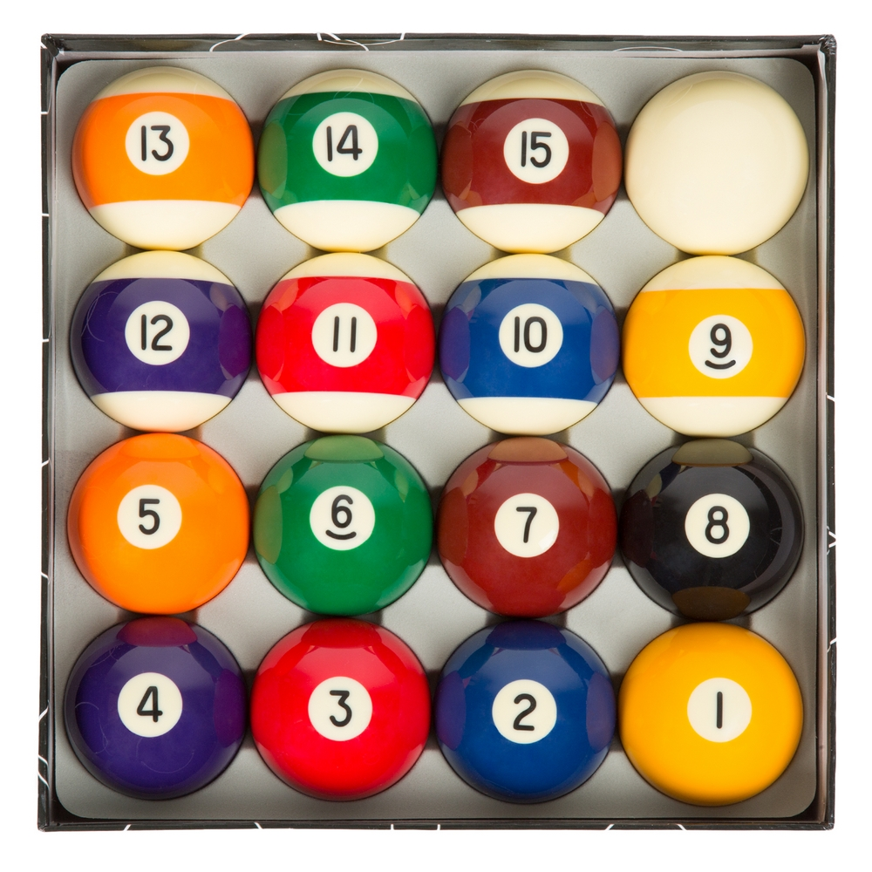
CP 1: Ordered Sampling without Replacement
Suppose we have 15 balls numbered 1 through 15 and we place them in a bag.
Suppose we draw a ball from the bag at random and get 5.
Then we draw again and get 1.
Then 3, then 7, then 15.

Slide 5
CP 1: Ordered Sampling without Replacement
Suppose we have a bag of 15 balls numbered 1 through 15, and we draw 5 in a row.
This is one possible outcome. CP1 asks "How many total outcomes are there?”
Enumerating them we’d get: [[1, 2, 3, 4, 5], [1, 2, 3, 4, 6], [1, 2, 3, 4, 7], … [5, 4, 3, 2, 1], …, [15, 14, 13, 12, 11]]. Far too many to count this way.
5, 1, 3, 7, 15

Slide 6
CP 1: Ordered Sampling without Replacement
Suppose we have a bag of 15 balls numbered 1 through 15, and we draw 5 in a row.
This is one possible outcome. CP1 asks "How many total outcomes are there?”
Number of possible balls we can draw first: 15.
5, 1, 3, 7, 15

Slide 7
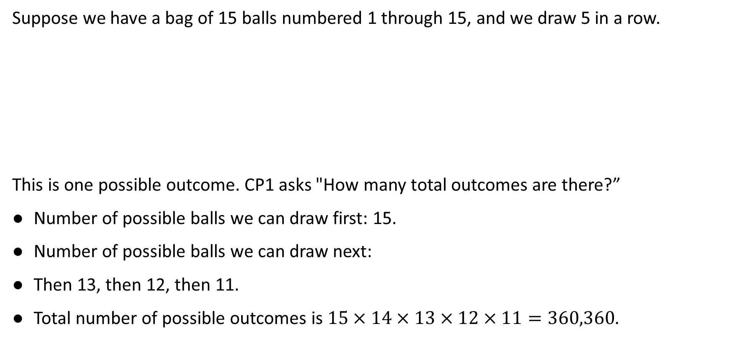

CP 1: Ordered Sampling without Replacement
Note: This slide renders differently on different operating systems. Sorry if it looks bad. Microsoft’s fault.
Suppose we have a bag of 15 balls numbered 1 through 15, and we draw 5 in a row.
This is one possible outcome. CP1 asks "How many total outcomes are there?”
Number of possible balls we can draw first: 15.
Number of possible balls we can draw next:
Then 13, then 12, then 11.
Total number of possible outcomes is $15×14×13×12×11=360,360$.
5, 1, 3, 7, 15
14 (because one ball is gone).
Can also write as $\frac{15!}{10!}$

Slide 8
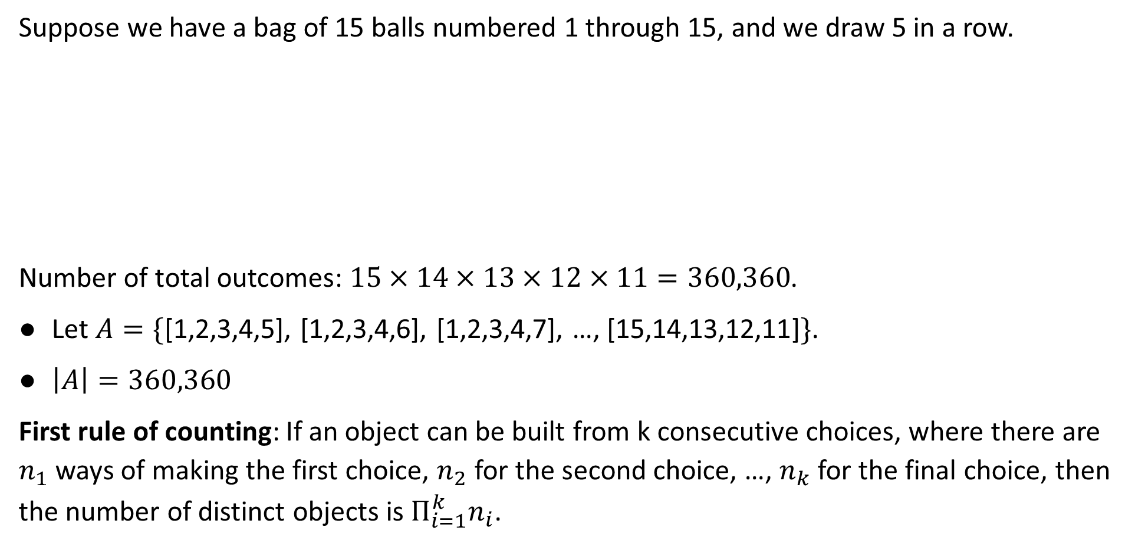
CP 1: Ordered Sampling without Replacement
Suppose we have a bag of 15 balls numbered 1 through 15, and we draw 5 in a row.
Number of total outcomes: $15×14×13×12×11=360,360$.
Let $A=\{$[1,2,3,4,5], [1,2,3,4,6], [1,2,3,4,7], …, [15,14,13,12,11]$\}$.
$\left|A\right|=360,360$
First rule of counting: If an object can be built from k consecutive choices, where there are $n_{1}$ ways of making the first choice, $n_{2}$ for the second choice, …, $n_{k}$ for the final choice, then the number of distinct objects is $Π_{i=1}^{k}n_{i}$.
5, 1, 3, 7, 15

Slide 9
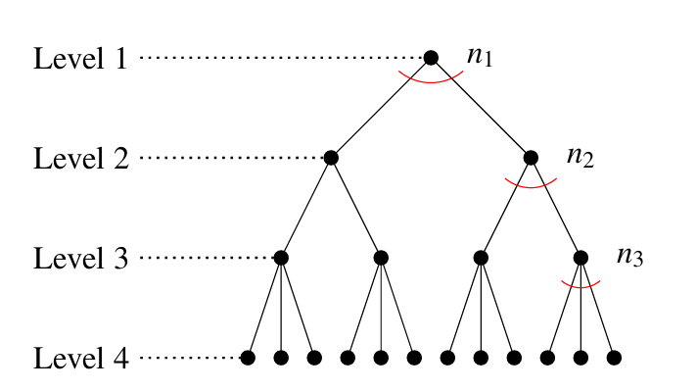
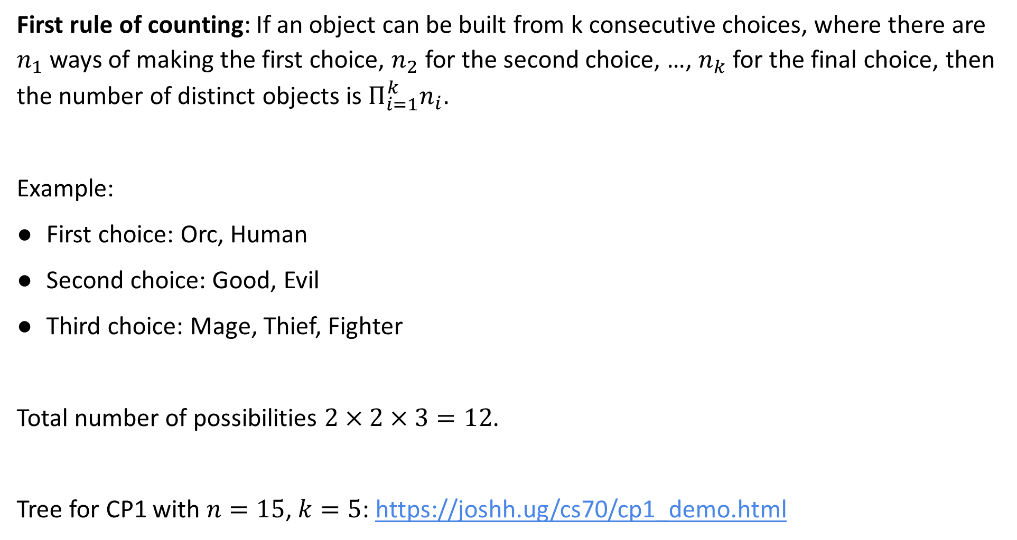
Tree Diagram for the First Rule of Counting
First rule of counting: If an object can be built from k consecutive choices, where there are $n_{1}$ ways of making the first choice, $n_{2}$ for the second choice, …, $n_{k}$ for the final choice, then the number of distinct objects is $Π_{i=1}^{k}n_{i}$.
Example:
First choice: Orc, Human
Second choice: Good, Evil
Third choice: Mage, Thief, Fighter
Total number of possibilities $2×2×3=12$.
Tree for CP1 with $n=15$, $k=5$: https://joshh.ug/cs70/cp1_demo.html

Slide 10

CP 1: General Formula for Counting Outcomes
Suppose we have a bag of $n$ balls numbered $1$ through $n$, and we draw $k$ in a row.
Number of total outcomes $\left|A\right|=n×(n−1)×(n−2)×…×(n−k+1)$.
Example: $n=15$, $k=5$, we have $\left|A\right|=15×14×…×11$
Can rewrite as $\left|A\right|=\frac{n!}{\left(n−k\right)! }$
Example: $\left|A\right|=\frac{15!}{10!}$

Slide 11
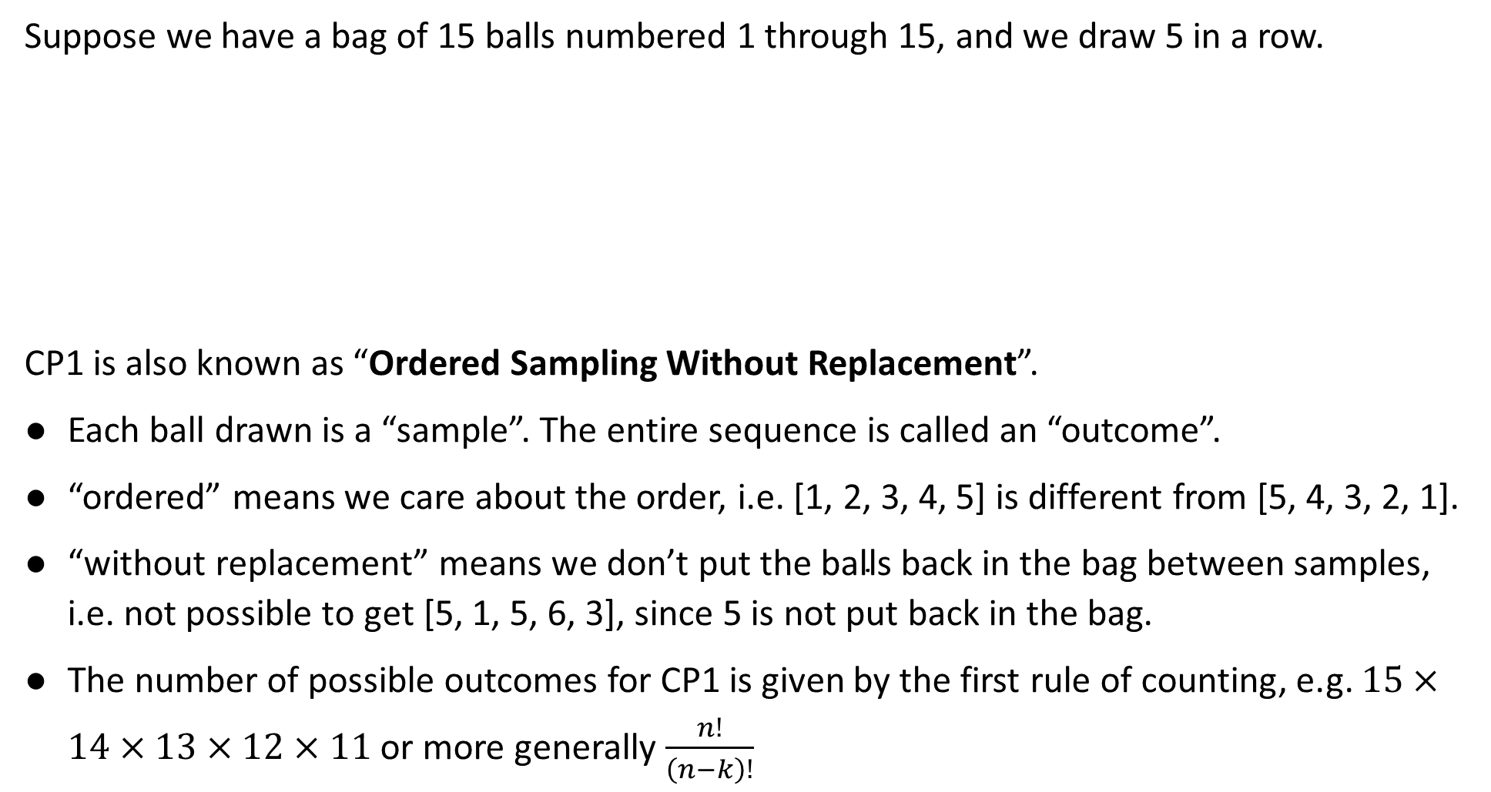
CP 1: Ordered Sampling without Replacement
Suppose we have a bag of 15 balls numbered 1 through 15, and we draw 5 in a row.
CP1 is also known as “Ordered Sampling Without Replacement”.
Each ball drawn is a “sample”. The entire sequence is called an “outcome”.
“ordered” means we care about the order, i.e. [1, 2, 3, 4, 5] is different from [5, 4, 3, 2, 1].
$\text{“}\text{without} \text{replacement}\text{” }\text{means} \text{we} \text{don}\text{’}\text{t} \text{put} \text{the} \text{balls} \text{back} \text{in} \text{the} \text{bag} \text{between} \text{samples}\text{, }\text{i}\text{.}\text{e}\text{. }\text{not} \text{possible} \text{to} \text{get}\text{ [5, 1, 5, 6, 3], }\text{since}\text{ 5 }\text{is} \text{not} \text{put} \text{back} \text{in} \text{the} \text{bag}$.
The number of possible outcomes for CP1 is given by the first rule of counting, e.g. $15×14×13×12×11$ or more generally $\frac{n!}{\left(n−k\right)!}$
5, 1, 3, 7, 15

Slide 12

Permutations
Let’s consider another counting problem. Suppose we have five letters ABCDE. Let A be the set of all permutations, i.e. $A=$ {ABCDE, ABCED, ABDCE, …, EDCBA}
What is $\left|A\right|$?

Slide 13
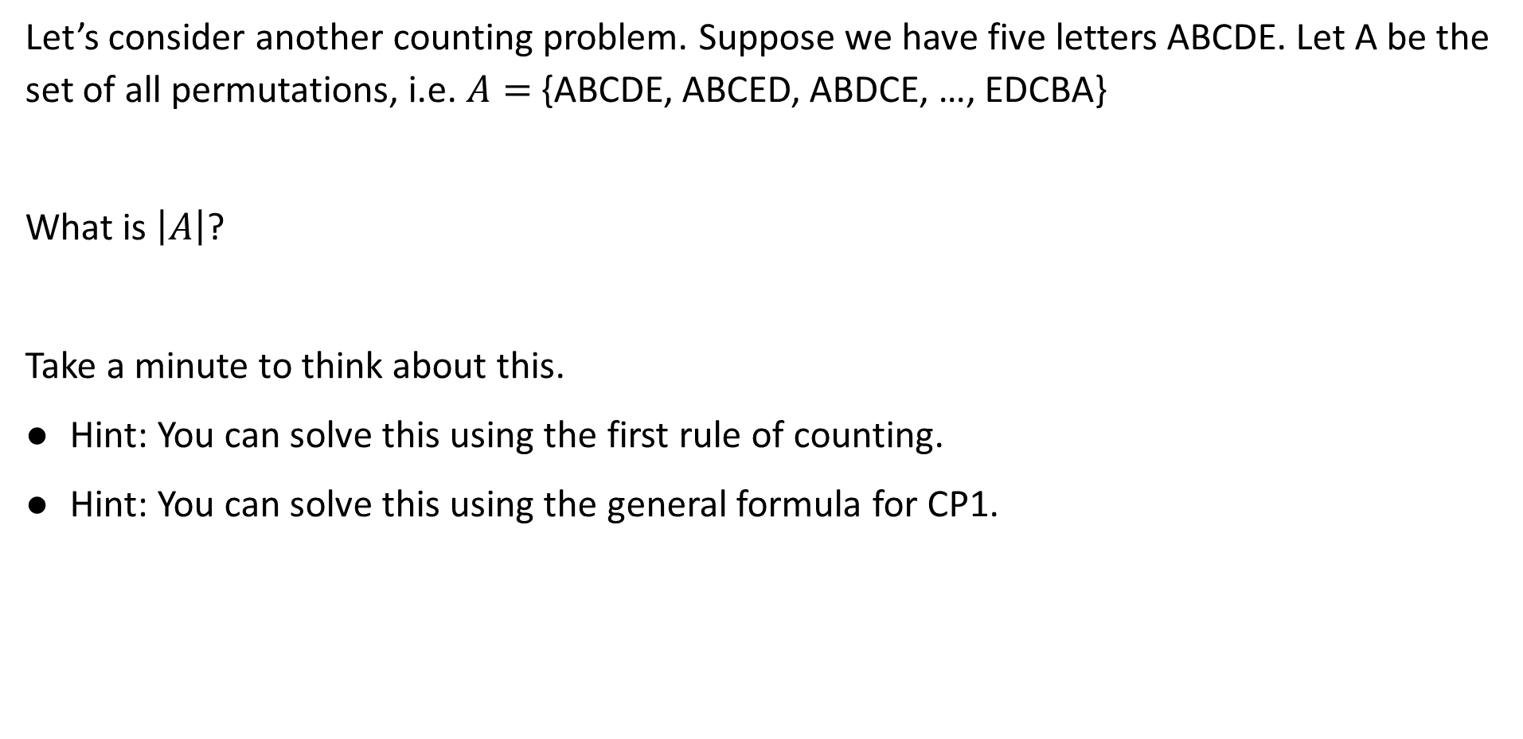
Permutations
Let’s consider another counting problem. Suppose we have five letters ABCDE. Let A be the set of all permutations, i.e. $A=$ {ABCDE, ABCED, ABDCE, …, EDCBA}
What is $\left|A\right|$?
Take a minute to think about this.
Hint: You can solve this using the first rule of counting.
Hint: You can solve this using the general formula for CP1.

Slide 14
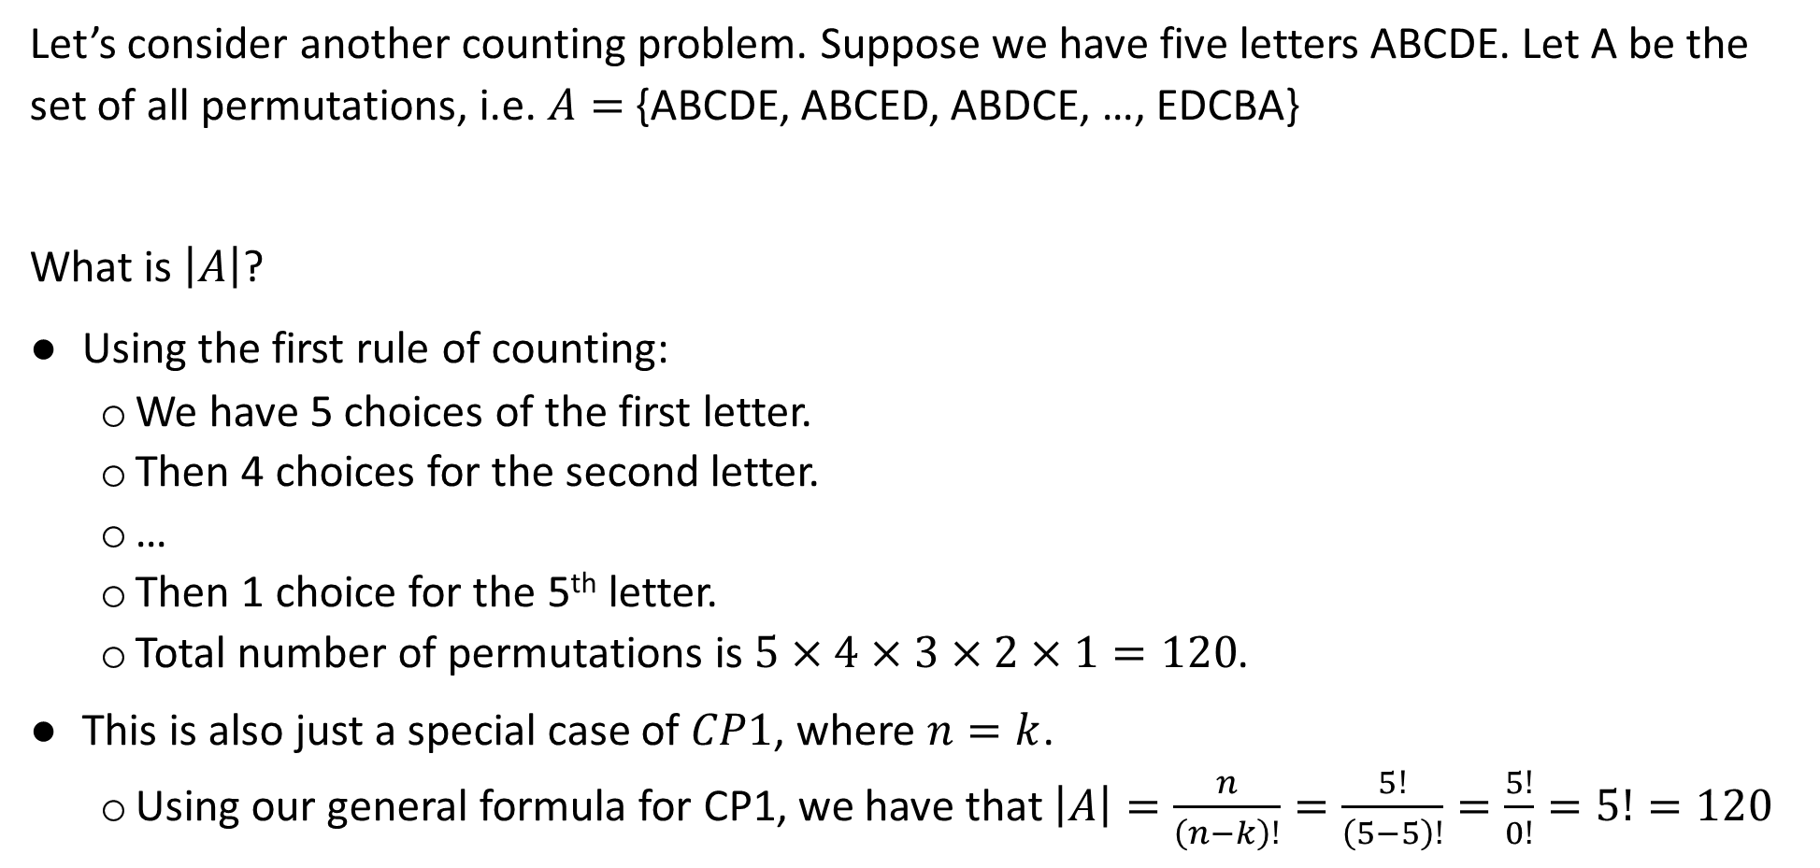
Permutations
Let’s consider another counting problem. Suppose we have five letters ABCDE. Let A be the set of all permutations, i.e. $A=$ {ABCDE, ABCED, ABDCE, …, EDCBA}
What is $\left|A\right|$?
Using the first rule of counting:
  We have 5 choices of the first letter.
  Then 4 choices for the second letter.
  …
  Then 1 choice for the 5th letter.
  Total number of permutations is $5×4×3×2×1=120$.
This is also just a special case of $CP1$, where $n=k$.
  Using our general formula for CP1, we have that $\left|A\right|=\frac{n}{\left(n−k\right)!}=\frac{5!}{\left(5−5\right)!}=\frac{5!}{0!}=5!=120$

Slide 15
CP2: Ordered Sampling with Replacement
Counting Problems:
CP1: Ordered Sampling without Replacement
CP2: Ordered Sampling with Replacement
CP3: Unordered Sampling without Replacement
CP4: Unordered Sampling with Replacement
Combinatorial Proofs (time permitting)
Lecture 12, CS70 Fall 2025

Slide 16
CP2: Ordered Sampling with Replacement
Suppose we place 15 balls numbered 1 through 15, then draw 5 in a row, putting the drawn ball back in the bag each time.
How many outcomes are there?
1, 1, 1, 1, 1

Slide 17
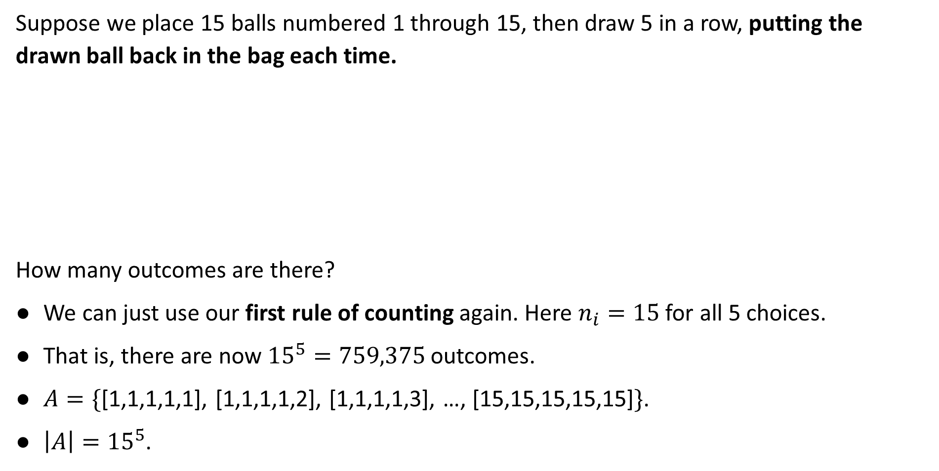
CP2: Ordered Sampling with Replacement
Suppose we place 15 balls numbered 1 through 15, then draw 5 in a row, putting the drawn ball back in the bag each time.
How many outcomes are there?
We can just use our first rule of counting again. Here $n_{i}=15$ for all 5 choices.
That is, there are now ${15}^{5}=759,375$ outcomes.
$A=\{$[1,1,1,1,1], [1,1,1,1,2], [1,1,1,1,3], …, [15,15,15,15,15]$\}$.
$\left|A\right|={15}^{5}$.
1, 1, 1, 1, 1

Slide 18
CP2: Ordered Sampling with Replacement
Suppose we place 15 balls numbered 1 through 15, then draw 5 in a row, putting the drawn ball back in the bag each time.
This process is also known as “Ordered Sampling With Replacement”.
“with replacement” means we put the balls back in the bag between samples, i.e. we can get [1, 2, 1, 10, 2] since balls go back in the bag after being drawn.
1, 1, 1, 1, 1

Slide 19
CP3: Unordered Sampling without Replacement
Counting Problems:
CP1: Ordered Sampling without Replacement
CP2: Ordered Sampling with Replacement
CP3: Unordered Sampling without Replacement
CP4: Unordered Sampling with Replacement
Combinatorial Proofs (time permitting)
Lecture 12, CS70 Fall 2025

Slide 20
CP3: Unordered Sampling without Replacement ($n=4$, $k=3$ example)
Suppose we place the letters A, B, C, and D in a bag. Suppose we draw 3 in a row. Assume we do NOT put the letters back between draws.
Suppose we don’t care about the order, i.e. we treat {B, D, A} the same as if we had drawn {A, B, D}. How many different ways are there to draw 3 letters?
To solve:
First temporarily pretend that order matters, i.e. consider CP1.
Then group together permutations, e.g. treat ABC the same as CBA.
A B C D
{B, D, A} (don’t care about order)

Slide 21
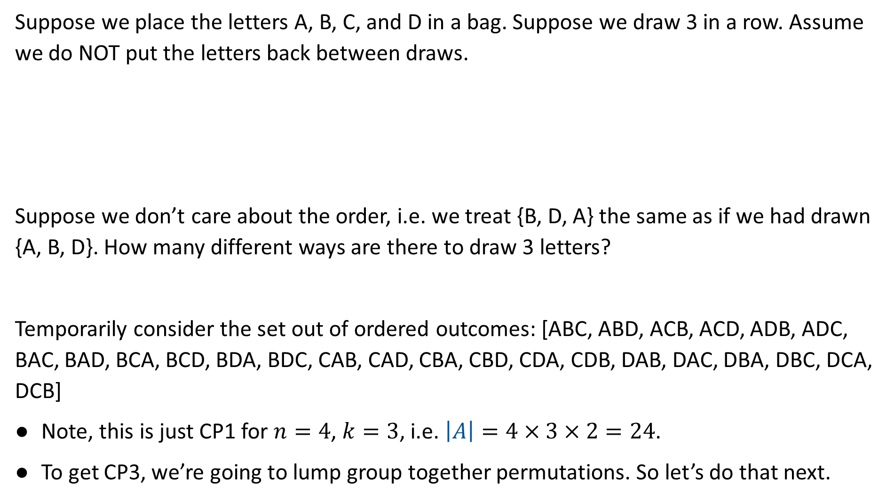
CP3: Unordered Sampling without Replacement ($n=4$, $k=3$ example)
Suppose we place the letters A, B, C, and D in a bag. Suppose we draw 3 in a row. Assume we do NOT put the letters back between draws.
Suppose we don’t care about the order, i.e. we treat {B, D, A} the same as if we had drawn {A, B, D}. How many different ways are there to draw 3 letters?
Temporarily consider the set out of ordered outcomes: [ABC, ABD, ACB, ACD, ADB, ADC, BAC, BAD, BCA, BCD, BDA, BDC, CAB, CAD, CBA, CBD, CDA, CDB, DAB, DAC, DBA, DBC, DCA, DCB]
Note, this is just CP1 for $n=4$, $k=3$, i.e. $\left|A\right|=4×3×2=24$.
To get CP3, we’re going to lump group together permutations. So let’s do that next.
A B C D
{B, D, A} (don’t care about order)

Slide 22
CP3: Unordered Sampling without Replacement ($n=4$, $k=3$ example)
Suppose we place the letters A, B, C, and D in a bag. Suppose we draw 3 in a row. Assume we do NOT put the letters back between draws.
Suppose we don’t care about the order, i.e. we treat {B, D, A} the same as if we had drawn {A, B, D}. How many different ways are there to draw 3 letters?
Temporarily consider the set out of ordered outcomes, then group together permutations: ABC, ABD, ACB, ACD, ADB, ADC, BAC, BAD, BCA, BCD, BDA, BDC, CAB, CAD, CBA, CBD, CDA, CDB, DAB, DAC, DBA, DBC, DCA, DCB
A B C D
{B, D, A} (don’t care about order)

Slide 23
CP3: Unordered Sampling without Replacement ($n=4$, $k=3$ example)
Suppose we place the letters A, B, C, and D in a bag. Suppose we draw 3 in a row. Assume we do NOT put the letters back between draws.
Suppose we don’t care about the order, i.e. we treat {B, D, A} the same as if we had drawn {A, B, D}. How many different ways are there to draw 3 letters?
Temporarily consider the set out of ordered outcomes, then group together permutations: ABC, ABD, ACB, ACD, ADB, ADC, BAC, BAD, BCA, BCD, BDA, BDC, CAB, CAD, CBA, CBD, CDA, CDB, DAB, DAC, DBA, DBC, DCA, DCB
A B C D
{B, D, A} (don’t care about order)

Slide 24
CP3: Unordered Sampling without Replacement ($n=4$, $k=3$ example)
Suppose we place the letters A, B, C, and D in a bag. Suppose we draw 3 in a row. Assume we do NOT put the letters back between draws.
Suppose we don’t care about the order, i.e. we treat {B, D, A} the same as if we had drawn {A, B, D}. How many different ways are there to draw 3 letters?
Temporarily consider the set out of ordered outcomes, then group together permutations: ABC, ABD, ACB, ACD, ADB, ADC, BAC, BAD, BCA, BCD, BDA, BDC, CAB, CAD, CBA, CBD, CDA, CDB, DAB, DAC, DBA, DBC, DCA, DCB
A B C D
{B, D, A} (don’t care about order)

Slide 25
CP3: Unordered Sampling without Replacement ($n=4$, $k=3$ example)
Suppose we place the letters A, B, C, and D in a bag. Suppose we draw 3 in a row. Assume we do NOT put the letters back between draws.
Suppose we don’t care about the order, i.e. we treat {B, D, A} the same as if we had drawn {A, B, D}. How many different ways are there to draw 3 letters?
Temporarily consider the set out of ordered outcomes, then group together permutations: ABC, ABD, ACB, ACD, ADB, ADC, BAC, BAD, BCA, BCD, BDA, BDC, CAB, CAD, CBA, CBD, CDA, CDB, DAB, DAC, DBA, DBC, DCA, DCB
A B C D
{B, D, A} (don’t care about order)

Slide 26
CP3: Unordered Sampling without Replacement ($n=4$, $k=3$ example)
Suppose we place the letters A, B, C, and D in a bag. Suppose we draw 3 in a row. Assume we do NOT put the letters back between draws.
Suppose we don’t care about the order, i.e. we treat {B, D, A} the same as if we had drawn {A, B, D}. How many different ways are there to draw 3 letters?
Temporarily consider the set out of ordered outcomes, then group together permutations: ABC, ACB, BAC, BCA, CAB, CBA, ABD, ADB, BAD, BDA, DAB, DBA, ACD, ADC, CAD, CDA, DAC, DCA, BCD, BDC, CBD, CDB, DBC, DCB
A B C D
{B, D, A} (don’t care about order)

Slide 27

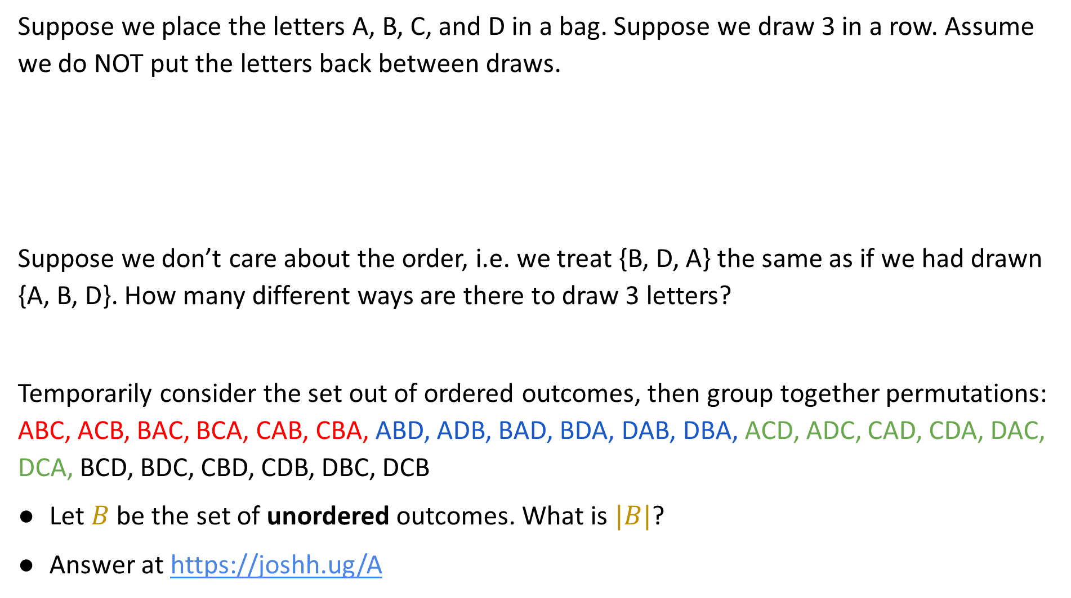
CP3: Unordered Sampling without Replacement ($n=4$, $k=3$ example)
Suppose we place the letters A, B, C, and D in a bag. Suppose we draw 3 in a row. Assume we do NOT put the letters back between draws.
Suppose we don’t care about the order, i.e. we treat {B, D, A} the same as if we had drawn {A, B, D}. How many different ways are there to draw 3 letters?
Temporarily consider the set out of ordered outcomes, then group together permutations: ABC, ACB, BAC, BCA, CAB, CBA, ABD, ADB, BAD, BDA, DAB, DBA, ACD, ADC, CAD, CDA, DAC, DCA, BCD, BDC, CBD, CDB, DBC, DCB
Let $B$ be the set of unordered outcomes. What is $|B|$?
Answer at https://joshh.ug/A
A B C D
{B, D, A} (don’t care about order)

Slide 28
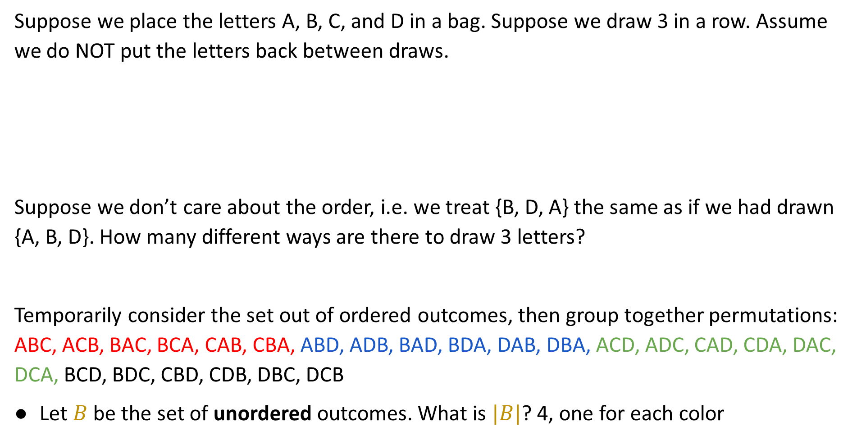
CP3: Unordered Sampling without Replacement ($n=4$, $k=3$ example)
Suppose we place the letters A, B, C, and D in a bag. Suppose we draw 3 in a row. Assume we do NOT put the letters back between draws.
Suppose we don’t care about the order, i.e. we treat {B, D, A} the same as if we had drawn {A, B, D}. How many different ways are there to draw 3 letters?
Temporarily consider the set out of ordered outcomes, then group together permutations: ABC, ACB, BAC, BCA, CAB, CBA, ABD, ADB, BAD, BDA, DAB, DBA, ACD, ADC, CAD, CDA, DAC, DCA, BCD, BDC, CBD, CDB, DBC, DCB
Let $B$ be the set of unordered outcomes. What is $|B|$? 4, one for each color
A B C D
{B, D, A} (don’t care about order)

Slide 29
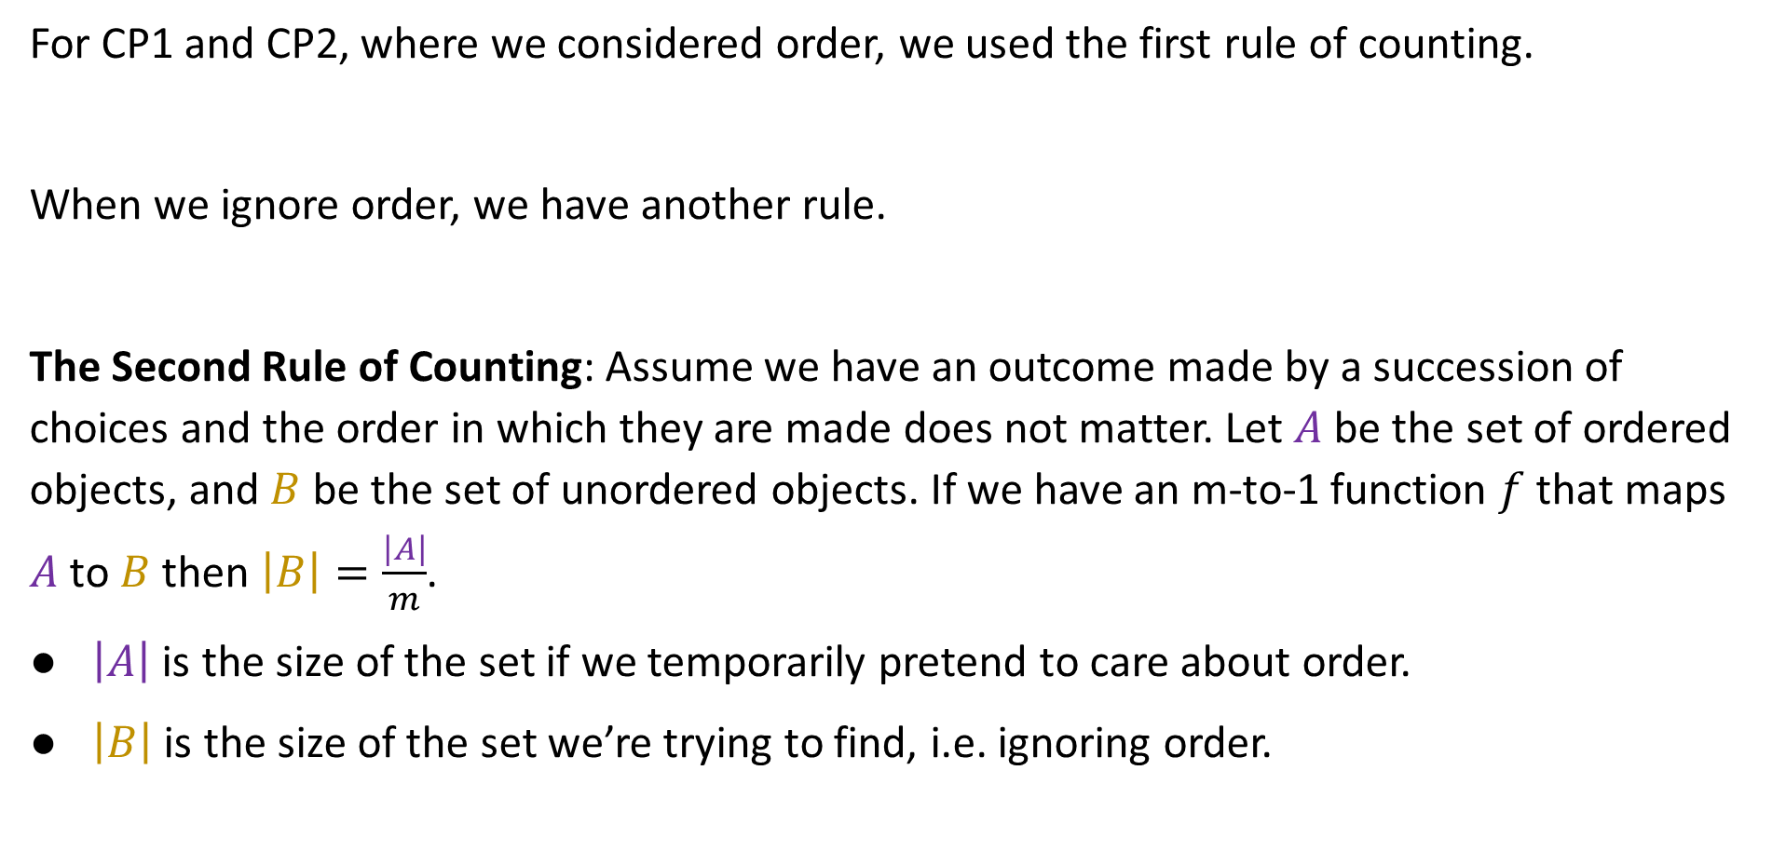
The Second Rule of Counting
For CP1 and CP2, where we considered order, we used the first rule of counting.
When we ignore order, we have another rule.
The Second Rule of Counting: Assume we have an outcome made by a succession of choices and the order in which they are made does not matter. Let $A$ be the set of ordered objects, and $B$ be the set of unordered objects. If we have an m-to-1 function $f$ that maps $A$ to $B$ then $\left|B\right|=\frac{\left|A\right|}{m}$.
$\left|A\right|$ is the size of the set if we temporarily pretend to care about order.
$\left|B\right|$ is the size of the set we’re trying to find, i.e. ignoring order.

Slide 30
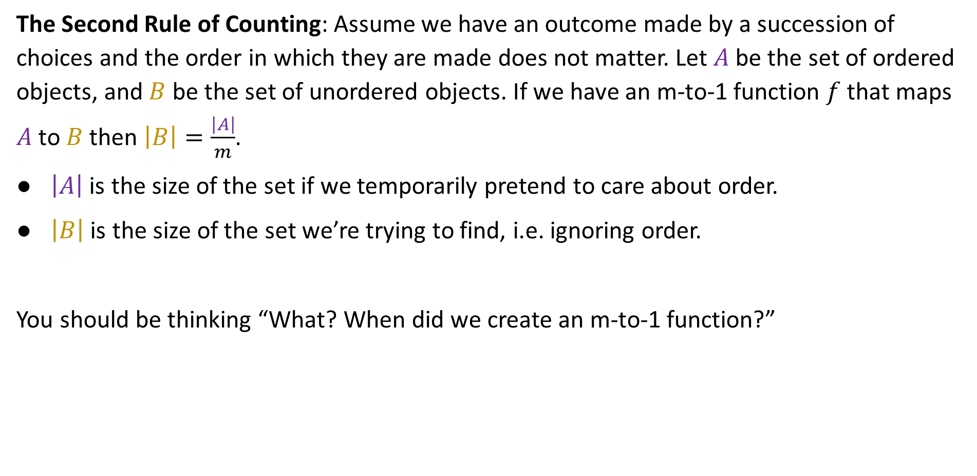
The Second Rule of Counting
The Second Rule of Counting: Assume we have an outcome made by a succession of choices and the order in which they are made does not matter. Let $A$ be the set of ordered objects, and $B$ be the set of unordered objects. If we have an m-to-1 function $f$ that maps $A$ to $B$ then $\left|B\right|=\frac{\left|A\right|}{m}$.
$\left|A\right|$ is the size of the set if we temporarily pretend to care about order.
$\left|B\right|$ is the size of the set we’re trying to find, i.e. ignoring order.
You should be thinking “What? When did we create an m-to-1 function?”

Slide 31
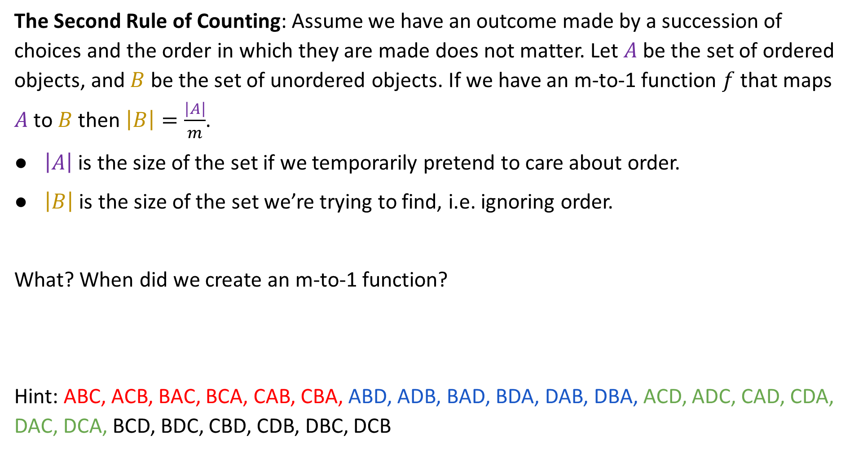
The Second Rule of Counting
The Second Rule of Counting: Assume we have an outcome made by a succession of choices and the order in which they are made does not matter. Let $A$ be the set of ordered objects, and $B$ be the set of unordered objects. If we have an m-to-1 function $f$ that maps $A$ to $B$ then $\left|B\right|=\frac{\left|A\right|}{m}$.
$\left|A\right|$ is the size of the set if we temporarily pretend to care about order.
$\left|B\right|$ is the size of the set we’re trying to find, i.e. ignoring order.
What? When did we create an m-to-1 function?
Hint: ABC, ACB, BAC, BCA, CAB, CBA, ABD, ADB, BAD, BDA, DAB, DBA, ACD, ADC, CAD, CDA, DAC, DCA, BCD, BDC, CBD, CDB, DBC, DCB

Slide 32

The Second Rule of Counting
The Second Rule of Counting: Assume we have an outcome made by a succession of choices and the order in which they are made does not matter. Let $A$ be the set of ordered objects, and $B$ be the set of unordered objects. If we have an m-to-1 function $f$ that maps $A$ to $B$ then $\left|B\right|=\frac{\left|A\right|}{m}$.
$\left|A\right|$ is the size of the set if we temporarily pretend to care about order.
$\left|B\right|$ is the size of the set we’re trying to find, i.e. ignoring order.
What? When did we create an m-to-1 function?
Your answer:
Hint: ABC, ACB, BAC, BCA, CAB, CBA, ABD, ADB, BAD, BDA, DAB, DBA, ACD, ADC, CAD, CDA, DAC, DCA, BCD, BDC, CBD, CDB, DBC, DCB

Slide 33
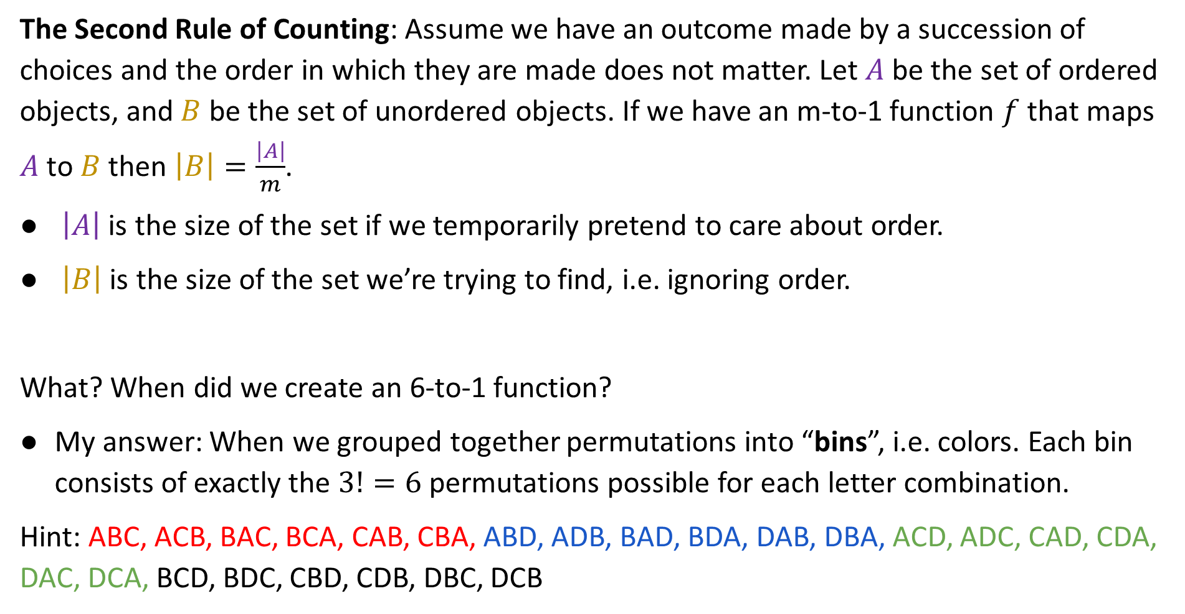
The Second Rule of Counting
The Second Rule of Counting: Assume we have an outcome made by a succession of choices and the order in which they are made does not matter. Let $A$ be the set of ordered objects, and $B$ be the set of unordered objects. If we have an m-to-1 function $f$ that maps $A$ to $B$ then $\left|B\right|=\frac{\left|A\right|}{m}$.
$\left|A\right|$ is the size of the set if we temporarily pretend to care about order.
$\left|B\right|$ is the size of the set we’re trying to find, i.e. ignoring order.
What? When did we create an 6-to-1 function?
My answer: When we grouped together permutations into “bins”, i.e. colors. Each bin consists of exactly the $3!=6$ permutations possible for each letter combination.
Hint: ABC, ACB, BAC, BCA, CAB, CBA, ABD, ADB, BAD, BDA, DAB, DBA, ACD, ADC, CAD, CDA, DAC, DCA, BCD, BDC, CBD, CDB, DBC, DCB

Slide 34
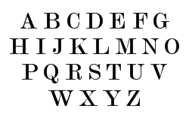
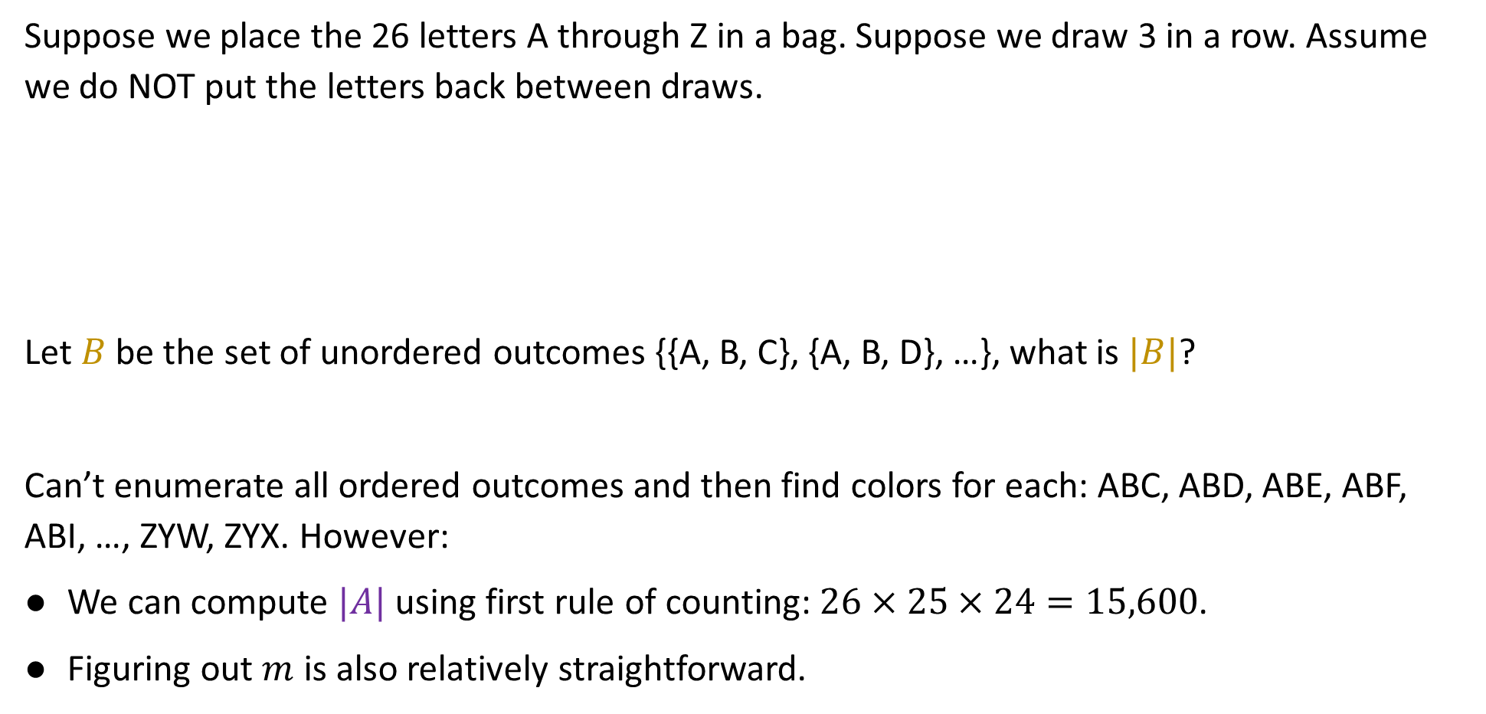
Example for $n=26$, $k=3$ [not covered in lecture, slides only]
Suppose we place the 26 letters A through Z in a bag. Suppose we draw 3 in a row. Assume we do NOT put the letters back between draws.
Let $B$ be the set of unordered outcomes {{A, B, C}, {A, B, D}, …}, what is $|B|$?
Can’t enumerate all ordered outcomes and then find colors for each: ABC, ABD, ABE, ABF, ABI, …, ZYW, ZYX. However:
We can compute $|A|$ using first rule of counting: $26×25×24=15,600$.
Figuring out $m$ is also relatively straightforward.
{B, D, A} (don’t care about order)

Slide 35
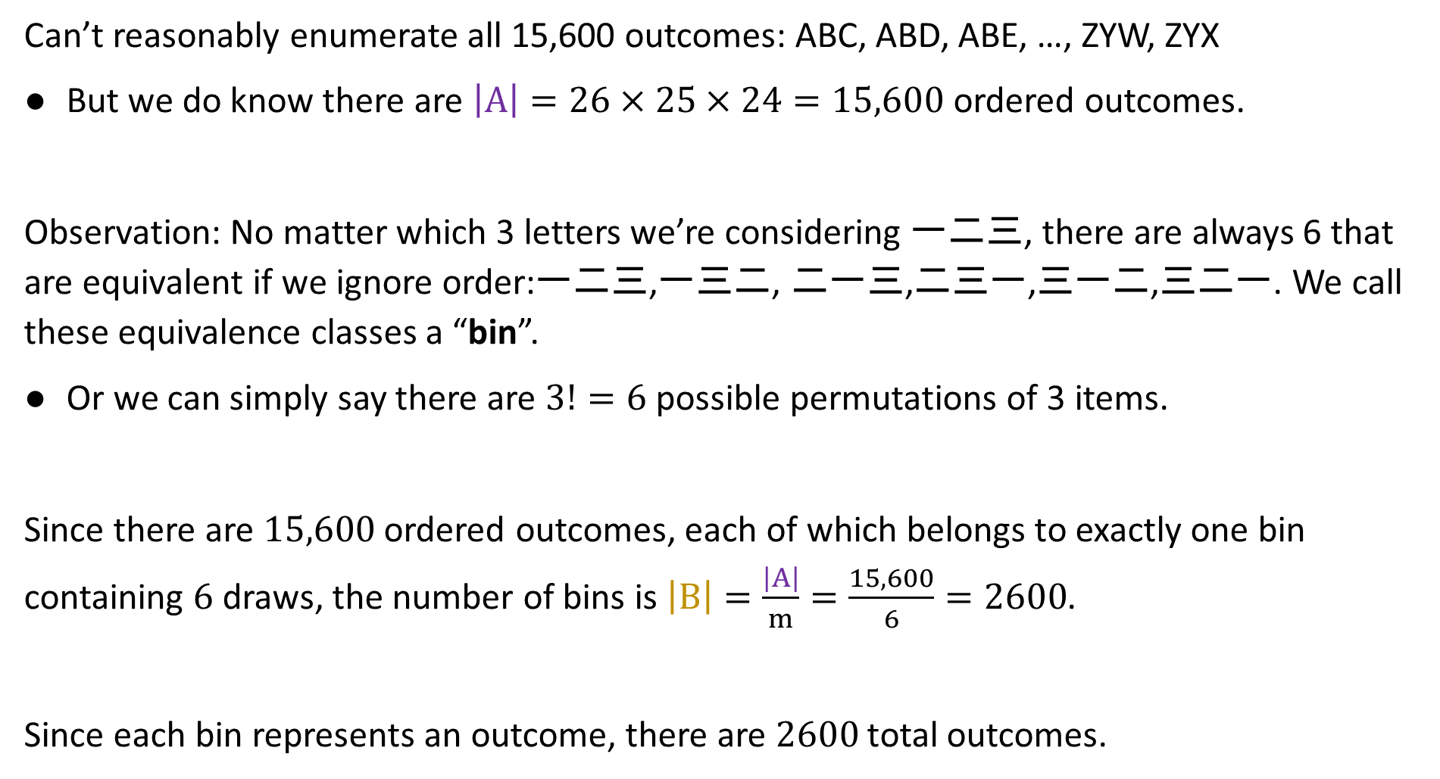
Example for $n=26$, $k=3$ [not covered in lecture, slides only]
Can’t reasonably enumerate all 15,600 outcomes: ABC, ABD, ABE, …, ZYW, ZYX
But we do know there are $\left|A\right|=26×25×24=15,600$ ordered outcomes.
Observation: No matter which 3 letters we’re considering 一二三, there are always 6 that are equivalent if we ignore order:一二三,一三二, 二一三,二三一,三一二,三二一. We call these equivalence classes a “bin”.
Or we can simply say there are $3!=6$ possible permutations of 3 items.
Since there are $15,600$ ordered outcomes, each of which belongs to exactly one bin containing $6$ draws, the number of bins is $\left|B\right|=\frac{\left|A\right|}{m}=\frac{15,600}{6}=2600$.
Since each bin represents an outcome, there are $2600$ total outcomes.

Slide 36
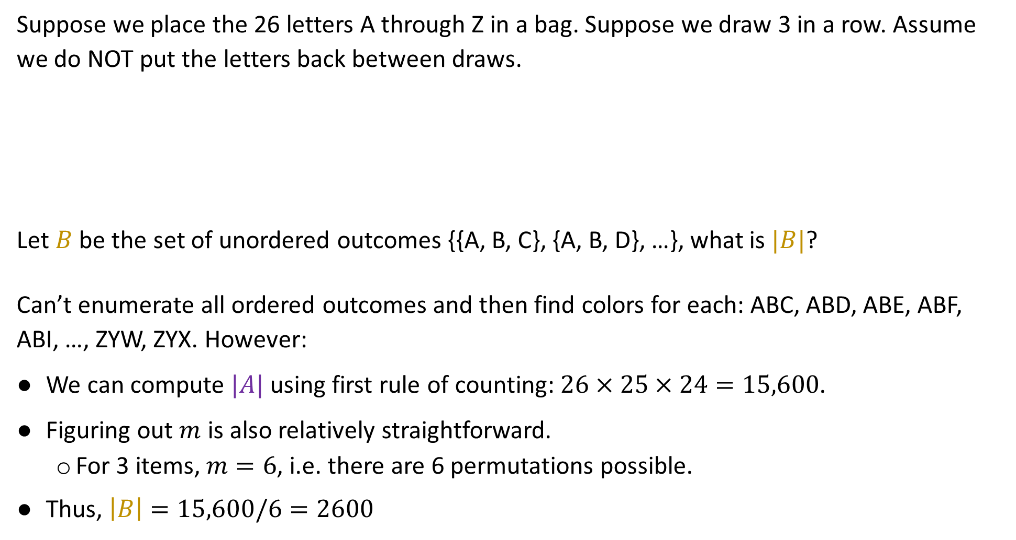
Example for $n=26$, $k=3$ [not covered in lecture, slides only]
Suppose we place the 26 letters A through Z in a bag. Suppose we draw 3 in a row. Assume we do NOT put the letters back between draws.
Let $B$ be the set of unordered outcomes {{A, B, C}, {A, B, D}, …}, what is $|B|$?
Can’t enumerate all ordered outcomes and then find colors for each: ABC, ABD, ABE, ABF, ABI, …, ZYW, ZYX. However:
We can compute $|A|$ using first rule of counting: $26×25×24=15,600$.
Figuring out $m$ is also relatively straightforward.
  For 3 items, $m=6$, i.e. there are 6 permutations possible.
Thus, $\left|B\right|=15,600/6=2600$
{B, D, A} (don’t care about order)

Slide 37

Unordered Sampling without Replacement, $n=26$, $k=5$
Suppose we place $n=26$ letters A through Z in a bag. Suppose we draw $k=5$ in a row. Assume we do NOT put the letters back between draws.
Let B be the set of unordered outcomes {{A, B, C, D, E}, {A, B, C, D, F}, …}, what is $|B|$?
{E, Z, X, Y, B} (don’t care about order)

Slide 38

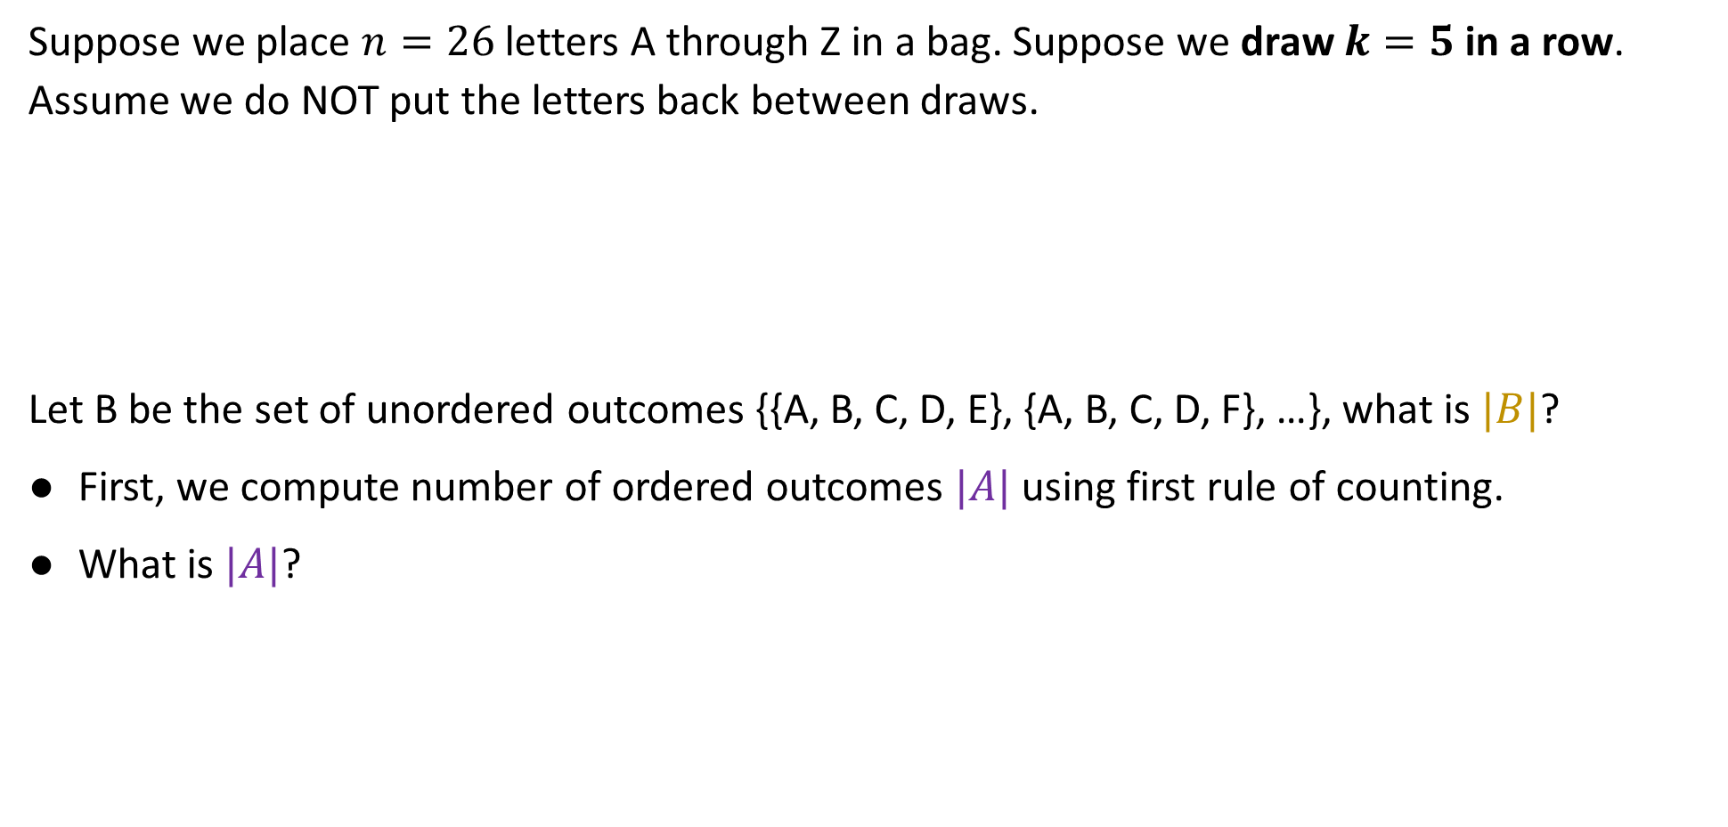
Unordered Sampling without Replacement, $n=26$, $k=5$
Suppose we place $n=26$ letters A through Z in a bag. Suppose we draw $k=5$ in a row. Assume we do NOT put the letters back between draws.
Let B be the set of unordered outcomes {{A, B, C, D, E}, {A, B, C, D, F}, …}, what is $|B|$?
First, we compute number of ordered outcomes $|A|$ using first rule of counting.
What is $|A|$?
{E, Z, X, Y, B} (don’t care about order)
https://joshh.ug/B

Slide 39
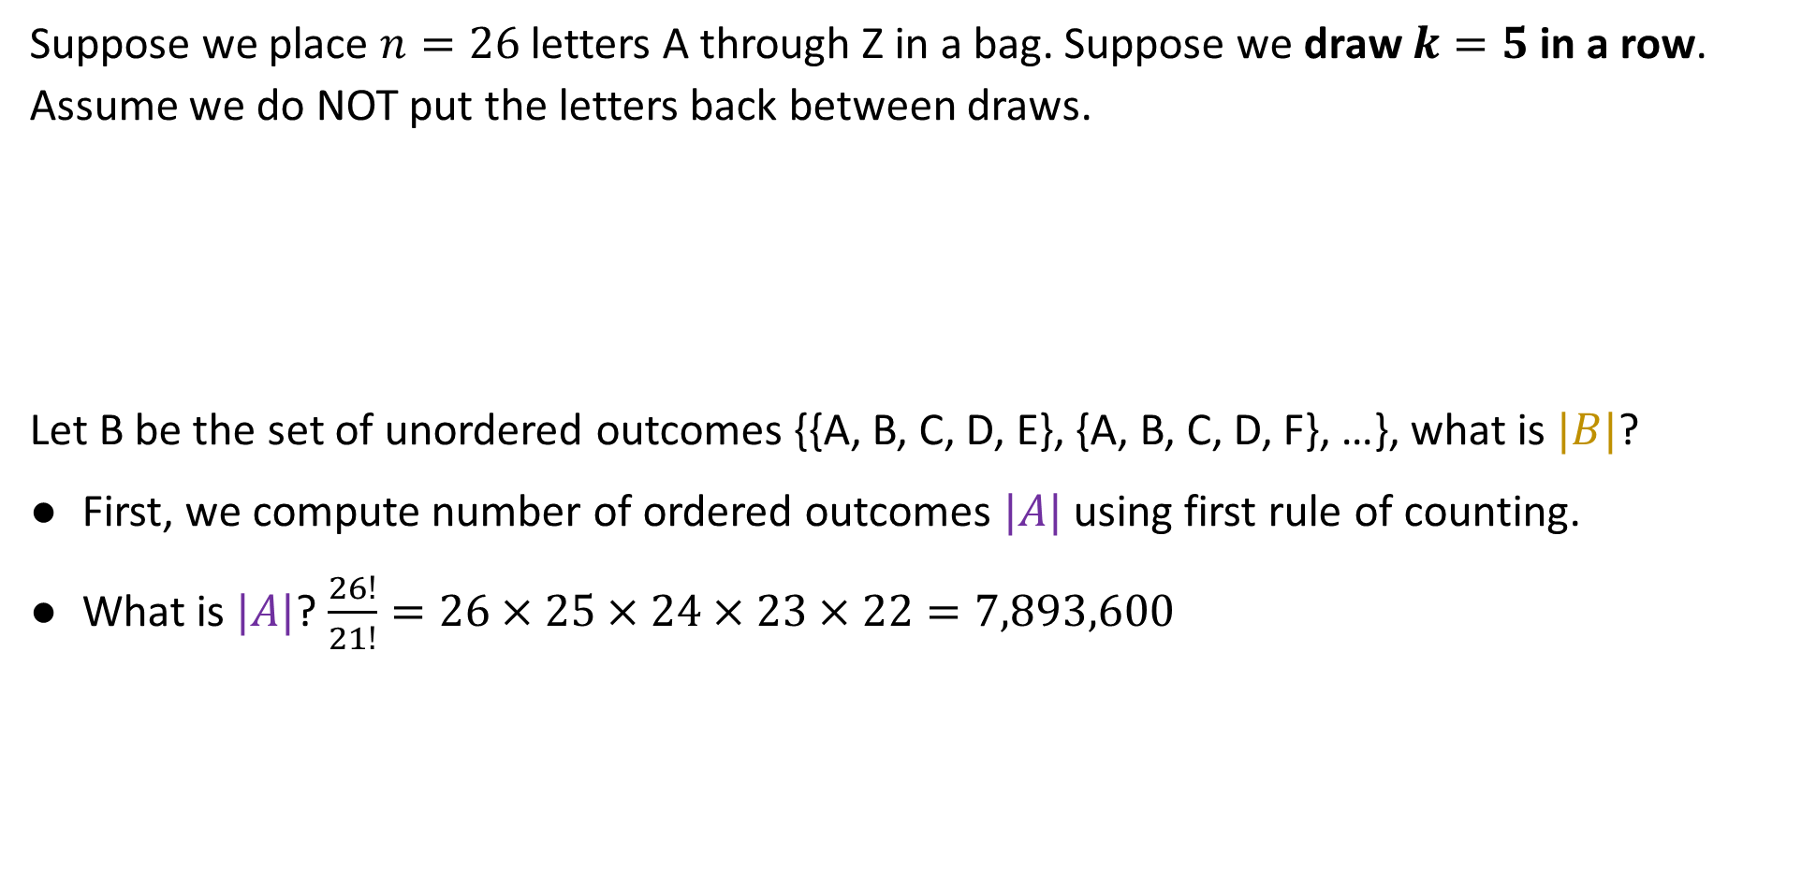
Unordered Sampling without Replacement, $n=26$, $k=5$
Suppose we place $n=26$ letters A through Z in a bag. Suppose we draw $k=5$ in a row. Assume we do NOT put the letters back between draws.
Let B be the set of unordered outcomes {{A, B, C, D, E}, {A, B, C, D, F}, …}, what is $|B|$?
First, we compute number of ordered outcomes $|A|$ using first rule of counting.
What is $|A|$? $\frac{26!}{21!}=26×25×24×23×22=7,893,600$
{E, Z, X, Y, B} (don’t care about order)

Slide 40

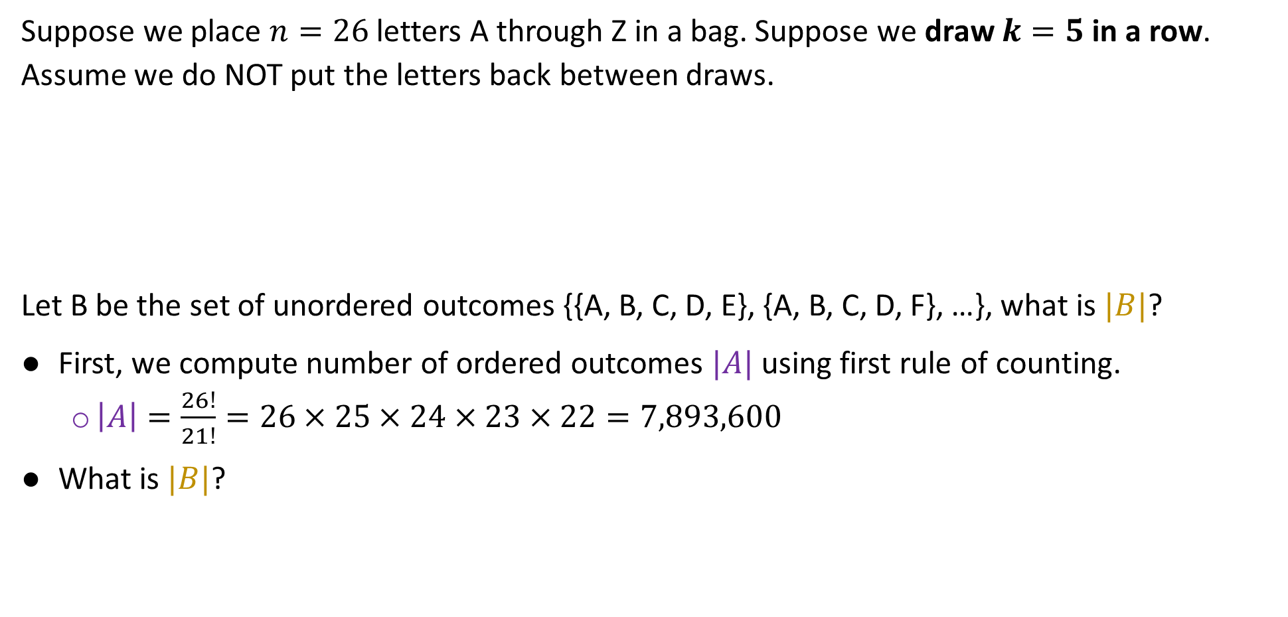
Unordered Sampling without Replacement, $n=26$, $k=5$
Suppose we place $n=26$ letters A through Z in a bag. Suppose we draw $k=5$ in a row. Assume we do NOT put the letters back between draws.
Let B be the set of unordered outcomes {{A, B, C, D, E}, {A, B, C, D, F}, …}, what is $|B|$?
First, we compute number of ordered outcomes $|A|$ using first rule of counting.
  $\left|A\right|=\frac{26!}{21!}=26×25×24×23×22=7,893,600$
What is $|B|$?
{E, Z, X, Y, B} (don’t care about order)
https://joshh.ug/C

Slide 41
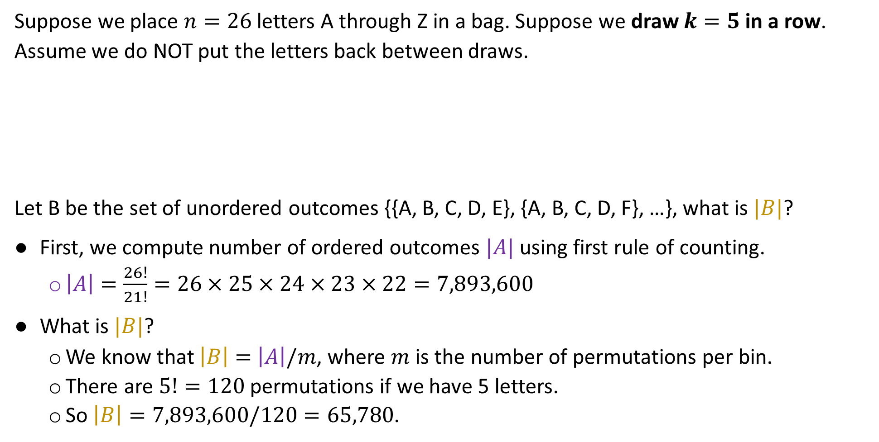
Unordered Sampling without Replacement, $n=26$, $k=5$
Suppose we place $n=26$ letters A through Z in a bag. Suppose we draw $k=5$ in a row. Assume we do NOT put the letters back between draws.
Let B be the set of unordered outcomes {{A, B, C, D, E}, {A, B, C, D, F}, …}, what is $|B|$?
First, we compute number of ordered outcomes $|A|$ using first rule of counting.
  $\left|A\right|=\frac{26!}{21!}=26×25×24×23×22=7,893,600$
What is $|B|$?
  We know that $\left|B\right|=$ $\left|A\right|/m$, where $m$ is the number of permutations per bin.
  There are $5!=120$ permutations if we have 5 letters.
  So $\left|B\right|=7,893,600/120=65,780$.
{E, Z, X, Y, B} (don’t care about order)

Slide 42
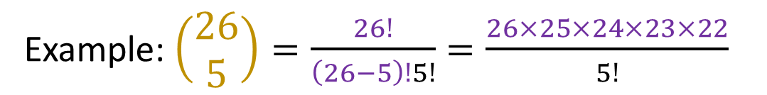
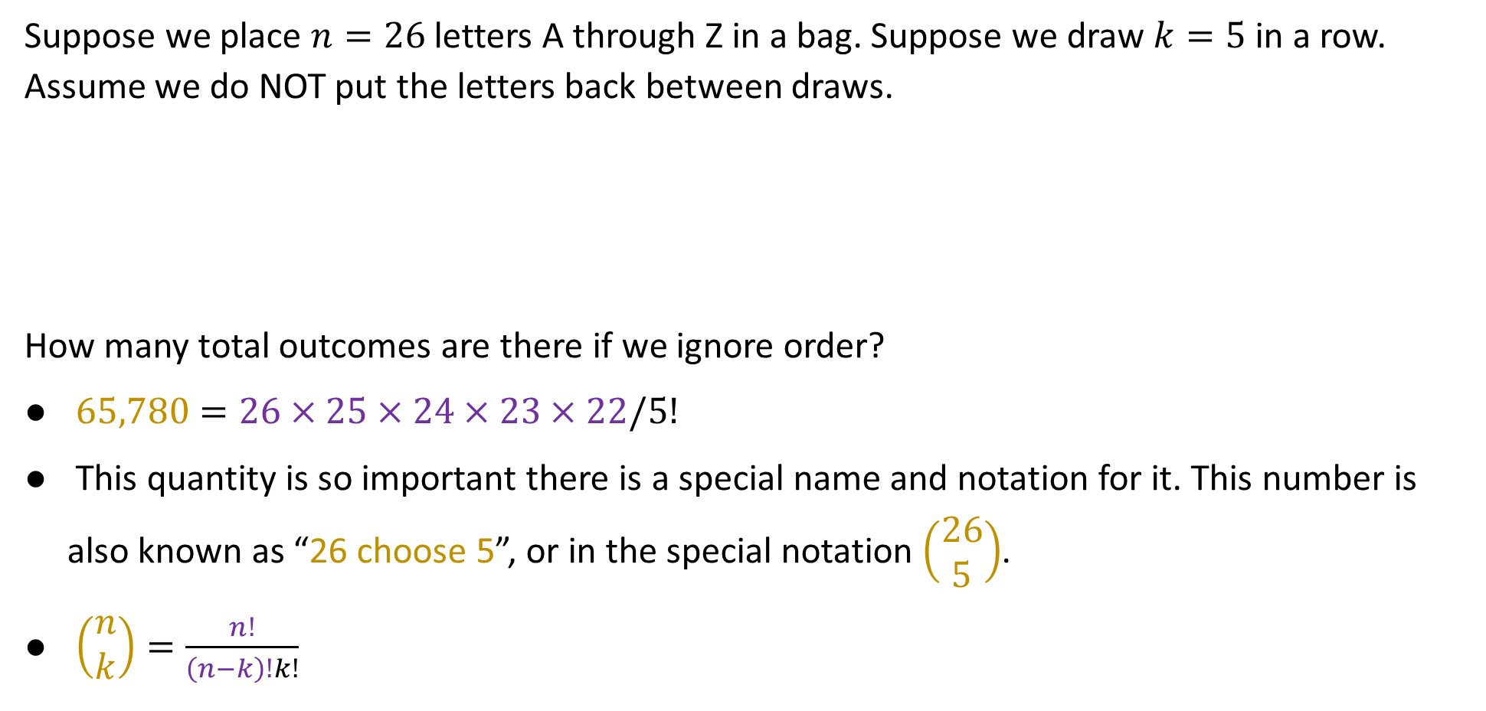
Unordered Sampling without Replacement, $n=26$, $k=5$
Suppose we place $n=26$ letters A through Z in a bag. Suppose we draw $k=5$ in a row. Assume we do NOT put the letters back between draws.
How many total outcomes are there if we ignore order?
$65,780=26×25×24×23×22/5!$
This quantity is so important there is a special name and notation for it. This number is also known as “26 choose 5”, or in the special notation $\left(\begin{matrix}26 \\ 5\end{matrix}\right)$.
$\left(\begin{matrix}n \\ k\end{matrix}\right)=\frac{n!}{\left(n−k\right)!k!}$
{E, Z, X, Y, B} (don’t care about order)
# ordered outcomes
Example:$\left(\begin{matrix}26 \\ 5\end{matrix}\right)=\frac{26!}{\left(26−5\right)!5!}=\frac{26×25×24×23×22}{5!}$
# ordered outcomes per bin (a.k.a. permutations)

Slide 43
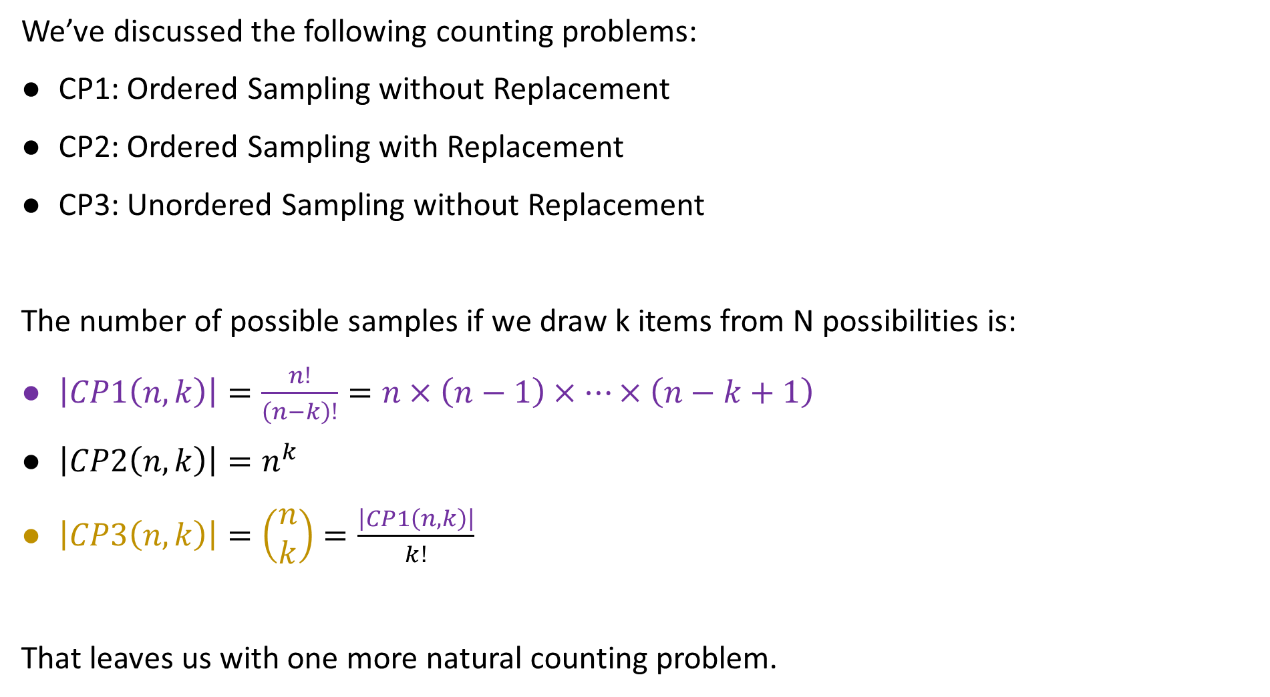
Counting Problems So Far
We’ve discussed the following counting problems:
CP1: Ordered Sampling without Replacement
CP2: Ordered Sampling with Replacement
CP3: Unordered Sampling without Replacement
The number of possible samples if we draw k items from N possibilities is:
$\left|CP1\left(n,k\right)\right|=\frac{n!}{\left(n−k\right)!}=n×\left(n−1\right)×…×\left(n−k+1\right)$
$\left|CP2\left(n,k\right)\right|=n^{k}$
$\left|CP3\left(n,k\right)\right|=\left(\begin{matrix}n \\ k\end{matrix}\right)=\frac{\left|CP1\left(n,k\right)\right|}{k!}$
That leaves us with one more natural counting problem.

Slide 44
CP4: Unordered Sampling with Replacement
Counting Problems:
CP1: Ordered Sampling without Replacement
CP2: Ordered Sampling with Replacement
CP3: Unordered Sampling without Replacement
CP4: Unordered Sampling with Replacement
Combinatorial Proofs (time permitting)
Lecture 12, CS70 Fall 2025

Slide 45

CP4: Unordered Sampling with Replacement
Suppose we place 3 balls with the letters X through Z on them, then draw 5 in a row, putting the drawn ball back in the bag each time.
Let’s call this CP4 with $n=3$, $k=5$.
{X, X, X, X, X}
X
Y
Z
{X, X, X, X, Y}
{X, X, Y, Y, Z}
Note: These are “multisets”. They allow duplicates but order doesn’t matter.

Slide 46
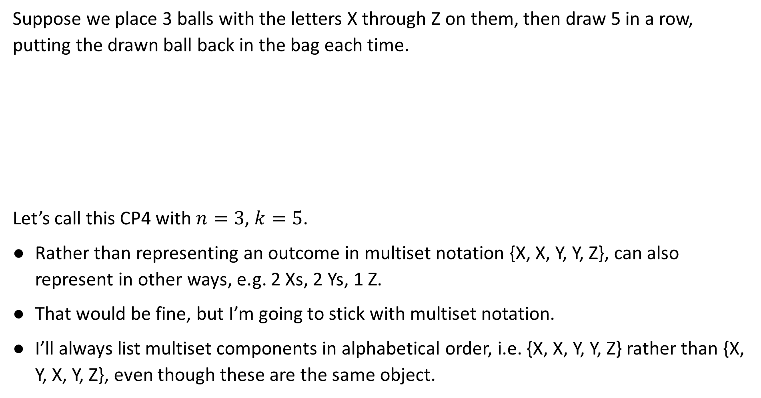
CP4: Unordered Sampling with Replacement (Quick Aside)
Suppose we place 3 balls with the letters X through Z on them, then draw 5 in a row, putting the drawn ball back in the bag each time.
Let’s call this CP4 with $n=3$, $k=5$.
Rather than representing an outcome in multiset notation {X, X, Y, Y, Z}, can also represent in other ways, e.g. 2 Xs, 2 Ys, 1 Z.
That would be fine, but I’m going to stick with multiset notation.
I’ll always list multiset components in alphabetical order, i.e. {X, X, Y, Y, Z} rather than {X, Y, X, Y, Z}, even though these are the same object.
5 Xs
X
Y
Z
4 Xs and 1 Y
2 Xs, 2 Ys, 1 Z

Slide 47
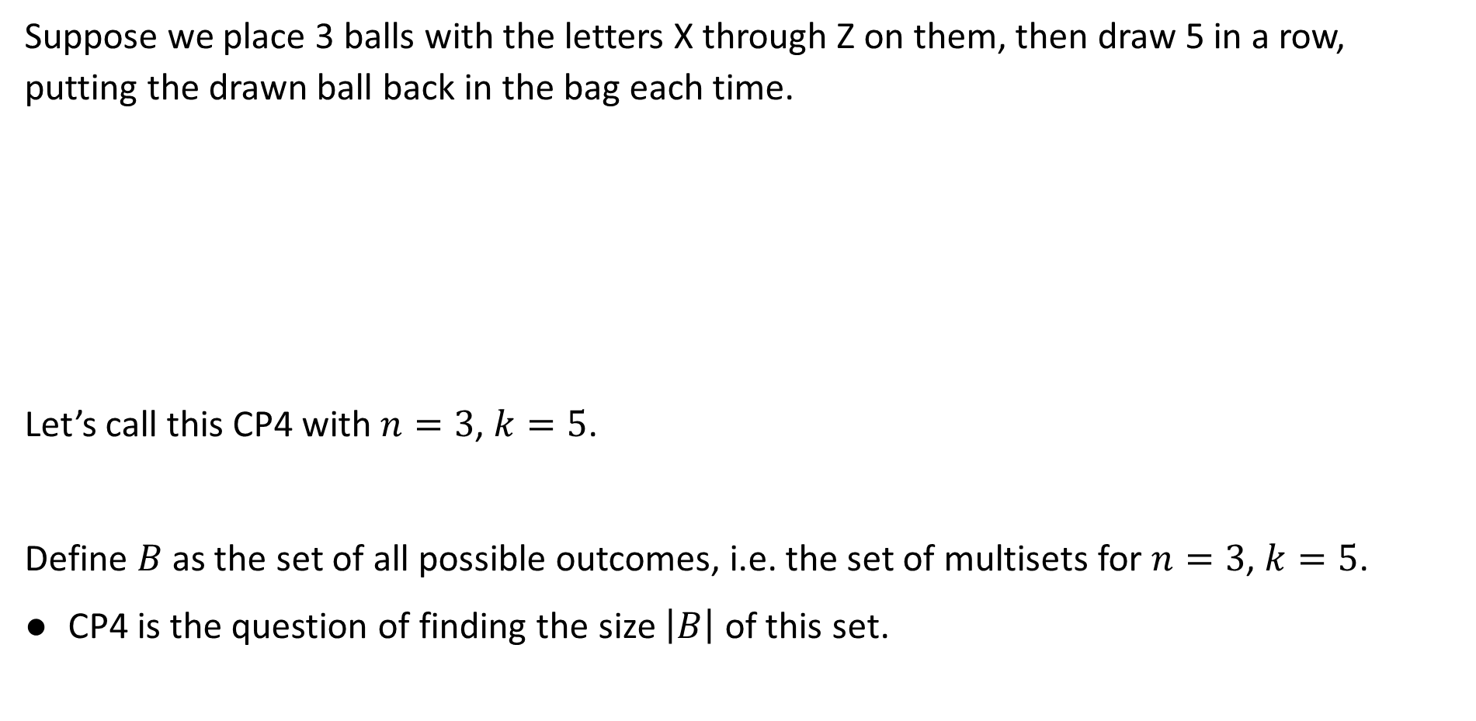
CP4: Unordered Sampling with Replacement
Suppose we place 3 balls with the letters X through Z on them, then draw 5 in a row, putting the drawn ball back in the bag each time.
Let’s call this CP4 with $n=3$, $k=5$.
Define $B$ as the set of all possible outcomes, i.e. the set of multisets for $n=3$, $k=5$.
CP4 is the question of finding the size $\left|B\right|$ of this set.
{X, X, X, X, X}
X
Y
Z
{X, X, X, X, Y}
{X, X, Y, Y, Z}
Note: These are “multisets”. They allow duplicates but order doesn’t matter.

Slide 48
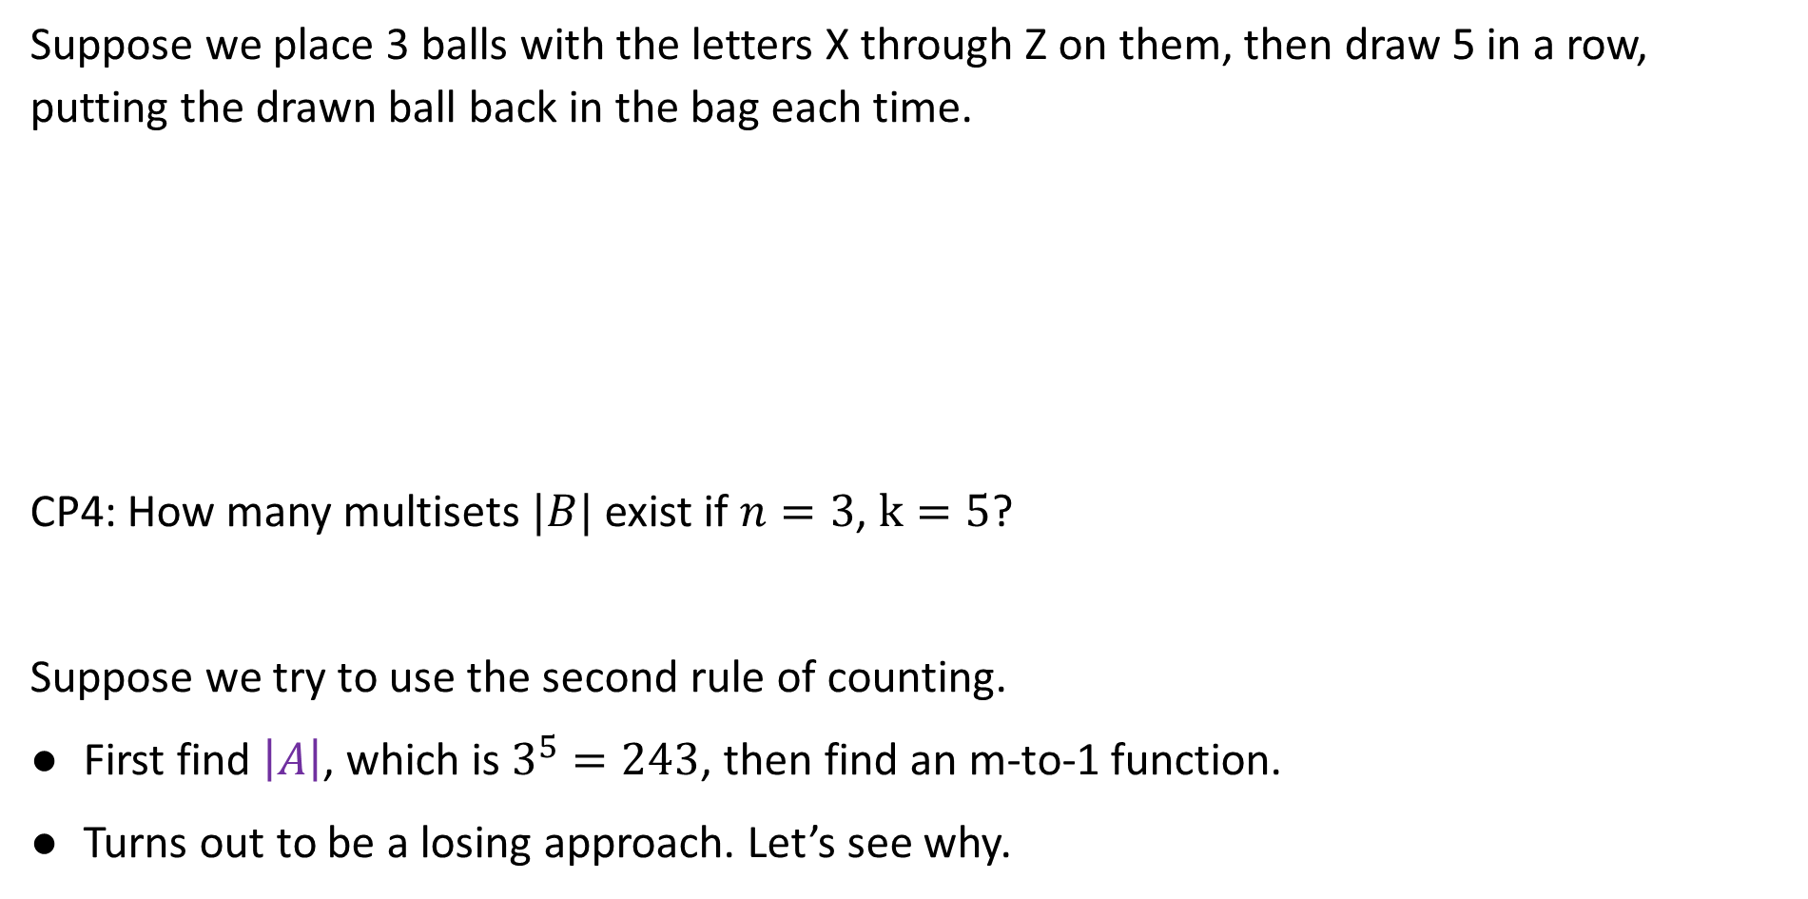
CP4: Unordered Sampling with Replacement
Suppose we place 3 balls with the letters X through Z on them, then draw 5 in a row, putting the drawn ball back in the bag each time.
CP4: How many multisets $|B|$ exist if $n=3$, $k=5$?
Suppose we try to use the second rule of counting.
First find $\left|A\right|$, which is $3^{5}=243$, then find an m-to-1 function.
Turns out to be a losing approach. Let’s see why.
{X, X, X, X, X}
X
Y
Z
{X, X, X, X, Y}
{X, X, Y, Y, Z}

Slide 49

Unordered Sampling with Replacement
Suppose we place 3 balls with the letters X through Z on them, then draw 5 in a row, putting the drawn ball back in the bag each time.
How many ordered outcomes are in the bin corresponding to {X, X, X, X, X}?
How many ordered outcomes are in the bin corresponding to {X, X, X, X, Y}?
https://joshh.ug/D
{X, X, X, X, X}
X
Y
Z
{X, X, X, X, Y}
{X, X, Y, Y, Z}

Slide 50
Unordered Sampling with Replacement
Suppose we place 3 balls with the letters X through Z on them, then draw 5 in a row, putting the drawn ball back in the bag each time.
How many ordered outcomes are in the bin corresponding to {X, X, X, X, X}?
Just 1, the sequence itself.
How many ordered outcomes are in the bin corresponding to {X, X, X, X, Y}?
There are 5: XXXXY, XXXYX, XXYXX, XYXXX, YXXXX.
{X, X, X, X, X}
X
Y
Z
{X, X, X, X, Y}
{X, X, Y, Y, Z}

Slide 51
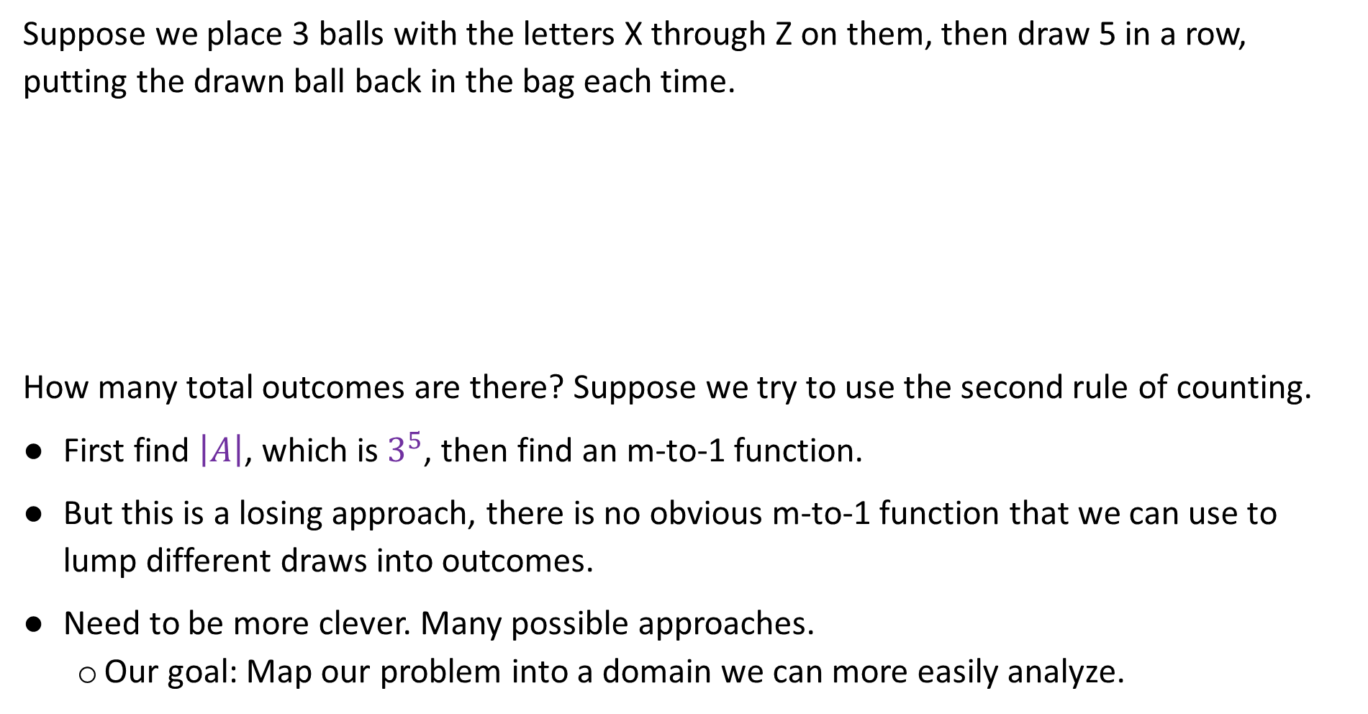
Unordered Sampling with Replacement
Suppose we place 3 balls with the letters X through Z on them, then draw 5 in a row, putting the drawn ball back in the bag each time.
How many total outcomes are there? Suppose we try to use the second rule of counting.
First find $\left|A\right|$, which is $3^{5}$, then find an m-to-1 function.
But this is a losing approach, there is no obvious m-to-1 function that we can use to lump different draws into outcomes.
Need to be more clever. Many possible approaches.
  Our goal: Map our problem into a domain we can more easily analyze.
{X, X, X, X, X}
X
Y
Z
{X, X, X, X, Y}
{X, X, Y, Y, Z}

Slide 52
Mapping One: The Slider Problem
Suppose we place 3 balls with the letters X through Z on them, then draw 5 in a row, putting the drawn ball back in the bag each time.
One approach: Imagine we have 3 different “sliders” that go from 0 to 5.
{X, X, X, X, X}
X
Y
Z
{X, X, X, X, Y}
{X, X, Y, Y, Z}
5
5
5
5
5
5
4
4
4
4
4
4
3
3
3
3
3
3
{X, X, X, X, Y}
{X, X, Y, Y, Z} →
2
2
2
2
2
2
1
1
1
1
1
1
0
0
0
0
0
0
# Xs
# Ys
# Zs
# Xs
# Ys
# Zs

Slide 53
Mapping One: The Slider Problem
Suppose we place 3 balls with the letters X through Z on them, then draw 5 in a row, putting the drawn ball back in the bag each time.
Which of the slider settings below is “valid”?
{X, X, X, X, X}
X
Y
Z
{X, X, X, X, Y}
{X, X, Y, Y, Z}
5
5
5
5
5
5
4
4
4
4
4
4
3
3
3
3
3
3
2
2
2
2
2
2
1
1
1
1
1
1
0
0
0
0
0
0
# Xs
# Ys
# Zs
# Xs
# Ys
# Zs

Slide 54
Mapping One: The Slider Problem
Suppose we place 3 balls with the letters X through Z on them, then draw 5 in a row, putting the drawn ball back in the bag each time.
Which of the slider settings below is “valid”? Must sum to 5!
{X, X, X, X, X}
X
Y
Z
{X, X, X, X, Y}
{X, X, Y, Y, Z}
5
5
5
5
5
5
4
4
4
4
4
4
3
3
3
3
3
3
2
2
2
2
2
2
1
1
1
1
1
1
0
0
0
0
0
0
# Xs
# Ys
# Zs
# Xs
# Ys
# Zs

Slide 55

Mapping One: The Slider Problem, Counting Valid Slider Positions
Let $A$ be the set of all valid slider positions. What is $|A|$?
The three sliders must sum to 5.
5
5
5
4
4
4
3
3
3
← {X, X, Y, Y, Z}
2
2
2
1
1
1
0
0
0
# Xs
# Ys
# Zs

Slide 56

Mapping One: The Slider Problem, Counting Valid Slider Positions
Let $A$ be the set of all valid slider positions. What is $|A|$?
The three sliders must sum to 5.
If X = 0, how many valid positions?
5
5
5
4
4
4
3
3
3
2
2
2
1
1
1
0
0
0
# Xs
# Ys
# Zs

Slide 57

Mapping One: The Slider Problem, Counting Valid Slider Positions
Let $A$ be the set of all valid slider positions. What is $|A|$?
The three sliders must sum to 5.
If X = 0, how many valid positions? 6
  If Y = 0, then Z = 5.
  If Y = 1, then Z = 4.
  …
  If Y = 5, then Z = 0.
5
5
5
4
4
4
3
3
3
2
2
2
1
1
1
0
0
0
# Xs
# Ys
# Zs

Slide 58

Mapping One: The Slider Problem, Counting Valid Slider Positions
Let $A$ be the set of all valid slider positions. What is $|A|$?
The three sliders must sum to 5.
If X = 0, how many valid positions? 6
  Y and Z must sum to 6.
5
5
5
4
4
4
3
3
3
2
2
2
1
1
1
0
0
0
# Xs
# Ys
# Zs

Slide 59

Mapping One: The Slider Problem, Counting Valid Slider Positions
Let $A$ be the set of all valid slider positions. What is $|A|$?
The three sliders must sum to 5.
If X = 0, how many valid positions? 6
If X = 1, how many valid positions?
5
5
5
4
4
4
3
3
3
2
2
2
1
1
1
0
0
0
# Xs
# Ys
# Zs

Slide 60

Mapping One: The Slider Problem, Counting Valid Slider Positions
Let $A$ be the set of all valid slider positions. What is $|A|$?
The three sliders must sum to 5.
If X = 0, how many valid positions? 6
If X = 1, how many valid positions? 5
  Y and Z must sum to 4.
5
5
5
4
4
4
3
3
3
2
2
2
1
1
1
0
0
0
# Xs
# Ys
# Zs

Slide 61

Mapping One: The Slider Problem, Counting Valid Slider Positions
Let $A$ be the set of all valid slider positions. What is $|A|$?
The three sliders must sum to 5.
If X = 0, how many valid positions? 6
If X = 1, how many valid positions? 5
…
If X = 5, how many valid positions?
5
5
5
4
4
4
3
3
3
2
2
2
1
1
1
0
0
0
# Xs
# Ys
# Zs

Slide 62
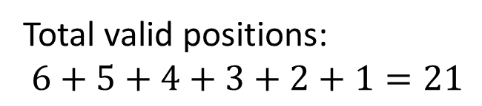

Mapping One: The Slider Problem, Counting Valid Slider Positions
Let $A$ be the set of all valid slider positions. What is $|A|$?
The three sliders must sum to 5.
If X = 0, how many valid positions? 6
If X = 1, how many valid positions? 5
…
If X = 5, how many valid positions? 1
Total valid positions:
$6+5+4+3+2+1=21$
5
5
5
4
4
4
3
3
3
2
2
2
1
1
1
0
0
0
# Xs
# Ys
# Zs

Slide 63
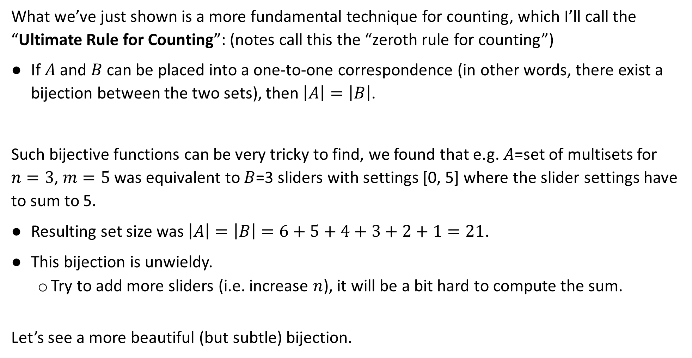
Ultimate Rule for Counting
What we’ve just shown is a more fundamental technique for counting, which I’ll call the “Ultimate Rule for Counting”: (notes call this the “zeroth rule for counting”)
If $A$ and $B$ can be placed into a one-to-one correspondence (in other words, there exist a bijection between the two sets), then $\left|A\right|=\left|B\right|$.
Such bijective functions can be very tricky to find, we found that e.g. $A$=set of multisets for $n=3$, $m=5$ was equivalent to $B$=3 sliders with settings [0, 5] where the slider settings have to sum to 5.
Resulting set size was $\left|A\right|=\left|B\right|=6+5+4+3+2+1=21$.
This bijection is unwieldy.
  Try to add more sliders (i.e. increase $n$), it will be a bit hard to compute the sum.
Let’s see a more beautiful (but subtle) bijection.

Slide 64
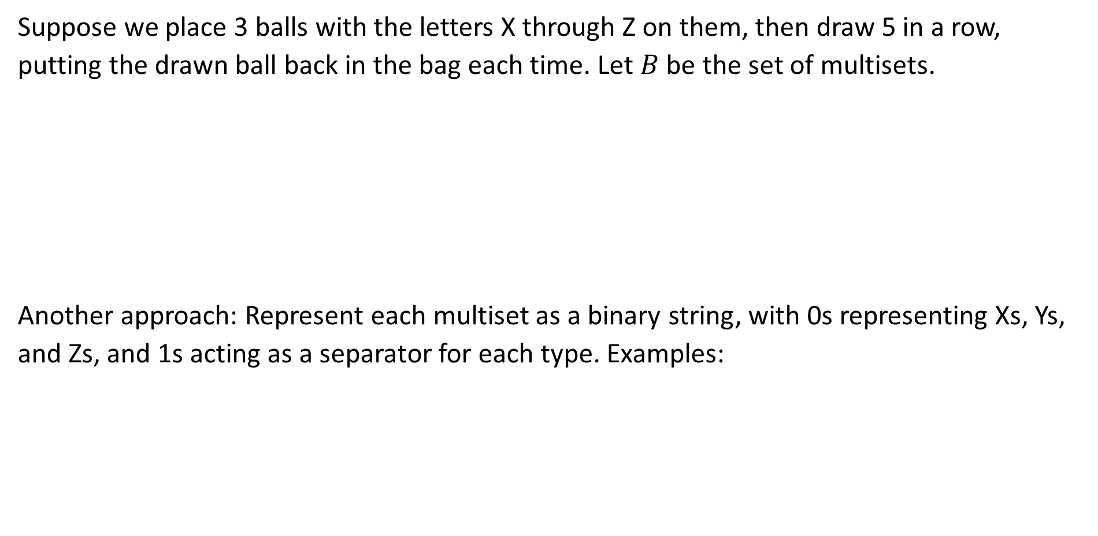
Unordered Sampling with Replacement
Suppose we place 3 balls with the letters X through Z on them, then draw 5 in a row, putting the drawn ball back in the bag each time. Let $B$ be the set of multisets.
Another approach: Represent each multiset as a binary string, with 0s representing Xs, Ys, and Zs, and 1s acting as a separator for each type. Examples:
{X, X, X, X, X}
X
Y
Z
{X, X, X, X, Y}
{X, X, Y, Y, Z}
0Y
2X
1Y
2Z
4X
1Z
XXYZZ: 0010100
XXXXZ: 0000110

Slide 65

Unordered Sampling with Replacement
Suppose we place 3 balls with the letters X through Z on them, then draw 5 in a row, putting the drawn ball back in the bag each time. Let $B$ be the set of multisets.
Another approach: Represent each multiset as a binary string, with 0s representing Xs, Ys, and Zs, and 1s acting as a separator for each type. Examples:
https://joshh.ug/E
{X, X, X, X, X}
X
Y
Z
{X, X, X, X, Y}
{X, X, Y, Y, Z}
0Y
2X
1Y
2Z
4X
1Z
XXYZZ: 0010100
XXXXZ: 0000110
XXYYZ: ???????

Slide 66
Unordered Sampling with Replacement
Suppose we place 3 balls with the letters X through Z on them, then draw 5 in a row, putting the drawn ball back in the bag each time. Let $B$ be the set of multisets.
Another approach: Represent each multiset as a binary string, with 0s representing Xs, Ys, and Zs, and 1s acting as a separator for each type. Examples:
{X, X, X, X, X}
X
Y
Z
{X, X, X, X, Y}
{X, X, Y, Y, Z}
0Y
2X
1Y
2Z
4X
1Z
XXYZZ: 0010100
XXXXZ: 0000110
XXYYZ: 0010010

Slide 67
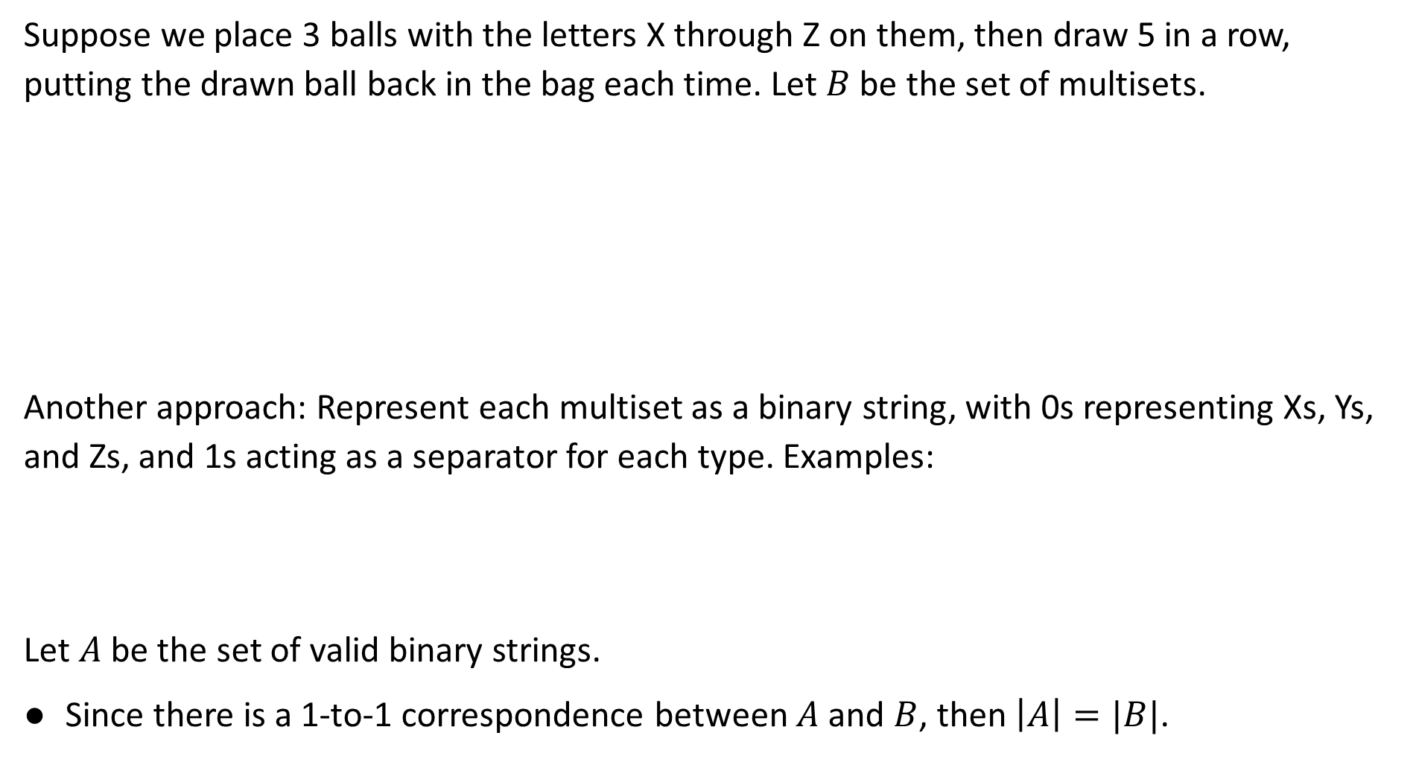
Unordered Sampling with Replacement
Suppose we place 3 balls with the letters X through Z on them, then draw 5 in a row, putting the drawn ball back in the bag each time. Let $B$ be the set of multisets.
Another approach: Represent each multiset as a binary string, with 0s representing Xs, Ys, and Zs, and 1s acting as a separator for each type. Examples:
Let $A$ be the set of valid binary strings.
Since there is a 1-to-1 correspondence between $A$ and $B$, then $\left|A\right|=|B|$.
{X, X, X, X, X}
X
Y
Z
{X, X, X, X, Y}
{X, X, Y, Y, Z}
0Y
2X
1Y
2Z
4X
1Z
XXYZZ: 0010100
XXXXZ: 0000110
XXYYZ: 0010010

Slide 68
Unordered Sampling with Replacement
Suppose we place 3 balls with the letters X through Z on them, then draw 5 in a row, putting the drawn ball back in the bag each time. Let $B$ be the set of multisets.
Another approach: Represent each multiset as a binary string, with 0s representing Xs, Ys, and Zs, and 1s acting as a separator for each type. Examples:
Let $A$ be the set of valid binary strings.
Since there is a 1-to-1 correspondence between $A$ and $B$, then $\left|A\right|=|B|$.
{X, X, X, X, X}
X
Y
Z
{X, X, X, X, Y}
{X, X, Y, Y, Z}
0Y
2X
1Y
2Z
4X
1Z
XXYZZ: 0010100
XXXXZ: 0000110
XXYYZ: 0010010

Slide 69
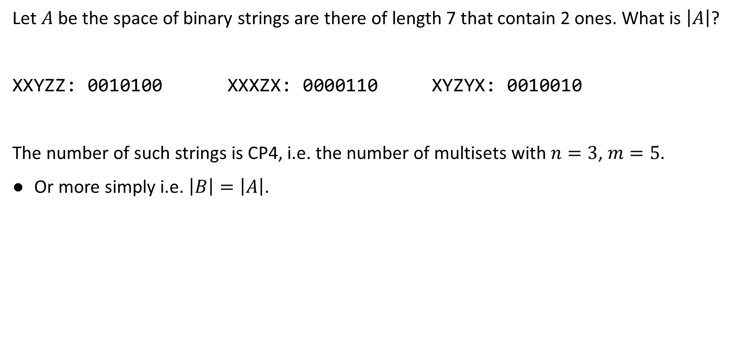
Subproblem: String Counting
Let $A$ be the space of binary strings are there of length 7 that contain 2 ones. What is $\left|A\right|$?
XXYZZ: 0010100 XXXZX: 0000110 XYZYX: 0010010
The number of such strings is CP4, i.e. the number of multisets with $n=3$, $m=5$.
Or more simply i.e. $\left|B\right|=\left|A\right|$.

Slide 70

Subproblem: String Counting
Let $A$ be the space of binary strings are there of length 7 that contain 2 ones. What is $\left|A\right|$?
XXYZZ: 0010100 XXXZX: 0000110 XYZYX: 0010010

Slide 71

Subproblem: String Counting
Let $A$ be the space of binary strings are there of length 7 that contain 2 ones. What is $\left|A\right|$?
XXYZZ: 0010100 XXXZX: 0000110 XYZYX: 0010010
Can you see how this is related to one of our previous counting problems?

Slide 72

Subproblem: String Counting
Let $A$ be the space of binary strings are there of length 7 that contain 2 ones. What is $\left|A\right|$?
XXYZZ: 0010100 XXXZX: 0000110 XYZYX: 0010010
The ones can be in position 1, 2, 3, 4, 5, 6, or 7.
In the first string, we “drew” 3 and 5.

Slide 73

Subproblem: String Counting
Let $A$ be the space of binary strings are there of length 7 that contain 2 ones. What is $\left|A\right|$?
XXYZZ: 0010100 XXXZX: 0000110 XYZYX: 0010010
The ones can be in position 1, 2, 3, 4, 5, 6, or 7.
In the first string, we “drew” 3 and 5.
In the second string, we ”drew” what?

Slide 74

Subproblem: String Counting
Let $A$ be the space of binary strings are there of length 7 that contain 2 ones. What is $\left|A\right|$?
XXYZZ: 0010100 XXXZX: 0000110 XYZYX: 0010010
The ones can be in position 1, 2, 3, 4, 5, 6, or 7.
In the first string, we “drew” 3 and 5.
In the second string, we ”drew” 5 and 6.
In the third string, we “drew”

Slide 75

Subproblem: String Counting
Let $A$ be the space of binary strings are there of length 7 that contain 2 ones. What is $\left|A\right|$?
XXYZZ: 0010100 XXXZX: 0000110 XYZYX: 0010010
The ones can be in position 1, 2, 3, 4, 5, 6, or 7.
In the first string, we “drew” 3 and 5.
In the second string, we ”drew” 5 and 6.
In the third string, we “drew” 3 and 6.

Slide 76


Subproblem: String Counting
Let $A$ be the space of binary strings are there of length 7 that contain 2 ones. What is $\left|A\right|$?
XXYZZ: 0010100 XXXZX: 0000110 XYZYX: 0010010
The ones can be in position 1, 2, 3, 4, 5, 6, or 7.
In the first string, we “drew” 3 and 5.
In the second string, we ”drew” 5 and 6.
In the third string, we “drew” 3 and 6.
So which counting problem is this?
No talking for this one.
https://joshh.ug/F
CP1: Ordered without Replacement
CP2: Ordered with Replacement
CP3: Unordered without Replacement

Slide 77

Subproblem: String Counting
Let $A$ be the space of binary strings are there of length 7 that contain 2 ones. What is $\left|A\right|$?
XXYZZ: 0010100 XXXZX: 0000110 XYZYX: 0010010
The ones can be in position 1, 2, 3, 4, 5, 6, or 7.
In the first string, we “drew” 3 and 5.
In the second string, we ”drew” 5 and 6.
In the third string, we “drew” 3 and 6.
So which counting problem is this?
Now talk to your neighbor.
CP1: Ordered without Replacement
CP2: Ordered with Replacement
CP3: Unordered without Replacement

Slide 78


Subproblem: String Counting
Let $A$ be the space of binary strings are there of length 7 that contain 2 ones. What is $\left|A\right|$?
XXYZZ: 0010100 XXXZX: 0000110 XYZYX: 0010010
The ones can be in position 1, 2, 3, 4, 5, 6, or 7.
In the first string, we “drew” 3 and 5.
In the second string, we ”drew” 5 and 6.
In the third string, we “drew” 3 and 6.
So which counting problem is this?
Try answering again.
https://joshh.ug/F
CP1: Ordered without Replacement
CP2: Ordered with Replacement
CP3: Unordered without Replacement

Slide 79
Subproblem: String Counting
Let $A$ be the space of binary strings are there of length 7 that contain 2 ones. What is $\left|A\right|$?
XXYZZ: 0010100 XXXZX: 0000110 XYZYX: 0010010
The ones can be in position 1, 2, 3, 4, 5, 6, or 7.
In the first string, we “drew” 3 and 5.
In the second string, we ”drew” 5 and 6.
In the third string, we “drew” 3 and 6.
https://joshh.ug/F
CP1: Ordered without Replacement
CP2: Ordered with Replacement
CP3: Unordered without Replacement

Slide 80

Subproblem: String Counting Solution
Let $A$ be the space of binary strings are there of length 7 that contain 2 ones. What is $\left|A\right|$?
XXYZZ: 0010100 XXXZX: 0000110 XYZYX: 0010010
The ones can be in position 1, 2, 3, 4, 5, 6, or 7.
In the first string, we “drew” 3 and 5.
So which counting problem is this? This is CP3 with $n=7$, $m=2$.
We are choosing the position of our 2 ones, where order doesn’t matter (i.e. doesn’t matter if we pick say “our ones are in position 5 and 7” or “our ones are in position 7 and 5”).
If you don’t believe me, make sure to revisit after lecture!

Slide 81





The CP4 - CP3 Bijection for $n=3$, $k=5$
CP4 for $n=3$, $k=5$: Draw 3 balls with the letters X through Z on them, then draw 5 in a row, putting the drawn ball back in the bag each time.
CP3 for $n=7$, $k=2$: Find number of binary strings with 7 digits, 2 of which are ones.
These two problems are identical.
More formally, there is a 1-to-1 mapping between the set of multisets $A$ and the set of binary strings $B$.
Solving is thus given by our formula $\left|CP3\left(7,2\right)\right|=\left(\begin{matrix}7 \\ 2\end{matrix}\right)=\frac{7!}{\left(7−2\right)!2!}=\frac{7×6}{2!}=21$
X, X, X, X, X
X
Y
Z
X, X, Y, X, X
X, Y, Z, X, Y
$$=\left(\begin{matrix}7 \\ 2\end{matrix}\right)$$
$$=\frac{7!}{\left(7−2\right)!2!}$$
$$=\frac{7×6}{2!}$$
$$=21$$

Slide 82

The CP4 - CP3 Bijection for for $n=4$, $k=7$
CP4: Now suppose we have $n=4$ balls with distinct letters, then draw $k=7$ in a row, putting the drawn ball back in the bag each time.
CP3 for $n′= ?$, $k′= ?$: Find number of binary strings with $n′$ digits, $k′$ of which are ones.
What are $n′$ and $k^{′}$ if $n=4$, $k=7$?
Example: For $n=3$, $k=5$, we had that $n^{′}=7$ and $k^{′}=2$.
{X, X, X, W, W, W, W}
W
X
Y
Z
{X, X, X, W, W, Y, Z}
{W, Y, Y, Y, Z, Z, Z}

Slide 83
The CP4 - CP3 Bijection for for $n=4$, $k=7$
CP4: Now suppose we have $n=4$ balls with distinct letters, then draw $k=7$ in a row, putting the drawn ball back in the bag each time.
CP3 for $n′= ?$, $k′= ?$: Find number of binary strings with $n′$ digits, $k′$ of which are ones.
What are $n′$ and $k^{′}$ if $n=4$, $k=7$?
Example: For $n=3$, $k=5$, we had that $n^{′}=7$ and $k^{′}=2$.
{X, X, X, W, W, W, W}
W
X
Y
Z
{X, X, X, W, W, Y, Z}
{W, Y, Y, Y, Z, Z, Z}
https://joshh.ug/H

Slide 84

The CP4 - CP3 Bijection for for $n=4$, $k=7$
CP4: Now suppose we have $n=4$ balls with distinct letters, then draw $k=7$ in a row, putting the drawn ball back in the bag each time.
CP3 for $n′= ?$, $k′= ?$: Find number of binary strings with $n′$ digits, $k′$ of which are ones.
What are $n′$ and $k^{′}$ if $n=4$, $k=7$?
Answer: $n^{′}=10$ and $k^{′}=3$.
  Strings are of length 10 and have 3 ones in them.
  Example: {W, Y, Y, Y, Z, Z, Z} goes with 0110001000
  One 0 for each element of multiset, one 1 for each separator.
{X, X, X, W, W, W, W}
W
X
Y
Z
{X, X, X, W, W, Y, Z}
{W, Y, Y, Y, Z, Z, Z}
{W, Y, Y, Y, Z, Z, Z}

Slide 85

The CP4 - CP3 Bijection for General $n$ and $k$
CP4: Draw $n$ balls with distinct letters, then draw $k$ in a row, putting the drawn ball back in the bag each time.
CP3 for $n′= ?$, $k′= ?$: Find number of binary strings with $n′$ digits, $k′$ of which are ones.
What are $n′$ and $k^{′}$ in terms of $n$ and $k$?
For $n=3$, $k=5$, we had that $n^{′}=7$ and $k^{′}=2$.
For $n=4$, $k=7$, we had that $n^{′}=10$ and $k^{′}=3$.
X, X, W, X, W, W, X
W
X
Y
Z
X, X, Z, X, W, Z, W
X, Y, Z, X, Y, W, X

Slide 86
The CP4 - CP3 Bijection for General $n$ and $k$
CP4: Draw $n$ balls with distinct letters, then draw $k$ in a row, putting the drawn ball back in the bag each time.
CP3 for $n′= ?$, $k′= ?$: Find number of binary strings with $n′$ digits, $k′$ of which are ones.
What are $n′$ and $k^{′}$ in terms of $n$ and $k$?
For $n=3$, $k=5$, we had that $n^{′}=7$ and $k^{′}=2$.
For $n=4$, $k=7$, we had that $n^{′}=10$ and $k^{′}=3$.
X, X, W, X, W, W, X
W
X
Y
Z
X, X, Z, X, W, Z, W
X, Y, Z, X, Y, W, X

Slide 87

The CP4 - CP3 Bijection for General $n$ and $k$
CP4: Draw $n$ balls with distinct letters, then draw $k$ in a row, putting the drawn ball back in the bag each time.
CP3 for $n′= ?$, $k′= ?$: Find number of binary strings with $n′$ digits, $k′$ of which are ones.
What are $n′$ and $k^{′}$ in terms of $n$ and $k$? $n^{′}=k+n−1$ and $k^{′}=n−1$.
For $n=3$, $k=5$, we had that $n^{′}=7$ and $k^{′}=2$.
For $n=4$, $k=7$, we had that $n^{′}=10$ and $k^{′}=3$.
Intepretation: $k+n−1$ total digits, $n−1$ of which are separators.
X, X, W, X, W, W, X
W
X
Y
Z
X, X, Z, X, W, Z, W
X, Y, Z, X, Y, W, X
If this isn’t clear, revisit after lecture!

Slide 88

Counting Problems Summary
CP1: Ordered Sampling without Replacement
CP2: Ordered Sampling with Replacement
CP3: Unordered Sampling without Replacement
CP4: Unordered Sampling with Replacement
The number of possible samples if we draw k items from N possibilities is:
$\left|CP1\left(n,k\right)\right|=\frac{n!}{\left(n−k\right)!}=n×\left(n−1\right)×…×\left(n−k+1\right)$
$\left|CP2\left(n,k\right)\right|=n^{k}$
$\left|CP3\left(n,k\right)\right|=\left(\begin{matrix}n \\ k\end{matrix}\right)=\frac{\left|CP1\left(n,k\right)\right|}{k!}$
$\left|CP4\left(n,k\right)\right|=\left|CP3\left(k+n−1,n−1\right)\right|=\left(\begin{matrix}k+n−1 \\ n−1\end{matrix}\right)$

Slide 89

Alternate Form for CP4
Earlier, we defined $A$ as the set of all binary strengths with length 7 that contain 2 ones, and found that $\left|A\right|=\left(\begin{matrix}7 \\ 2\end{matrix}\right)$.
XXYZZ: 0010100 XXXZX: 0000110 XYZYX: 0010010
But we could also have counted the number of ways to draw the positions of the zeros. In other, can reword $C$ as the set of all binary strengths with length 7 that contain 5 zeros.
In the first string, we “drew” 1, 2, 4, 6, and 7.
This suggests that $\left|A\right|=\left(\begin{matrix}7 \\ 5\end{matrix}\right)$. But how can this be?

Slide 90

Alternate Form for CP4
Earlier, we defined $A$ as the set of all binary strengths with length 7 that contain 2 ones, and found that $\left|A\right|=\left(\begin{matrix}7 \\ 2\end{matrix}\right)$.
XXYZZ: 0010100 XXXZX: 0000110 XYZYX: 0010010
But we could also have counted the number of ways to draw the positions of the zeros. In other, can reword $C$ as the set of all binary strengths with length 7 that contain 5 zeros.
In the first string, we “drew” 1, 2, 4, 6, and 7.
This suggests that $\left|A\right|=\left(\begin{matrix}7 \\ 5\end{matrix}\right)$. But how can this be? Well, $\left(\begin{matrix}7 \\ 2\end{matrix}\right)=\left(\begin{matrix}7 \\ 5\end{matrix}\right)$
Randomly picking the positions of the two 1s is same thing as picking five 0s.
See hidden slide after this slide for a more algebraic look at this.

Slide 91





Handy Property of the Choose Function
It turns out that $\left(\begin{matrix}N \\ K\end{matrix}\right)=\left(\begin{matrix}N \\ N−K\end{matrix}\right)$, example $\left(\begin{matrix}7 \\ 2\end{matrix}\right)=\left(\begin{matrix}7 \\ 5\end{matrix}\right)$ Why?
Let’s expand out both expressions, we have that:
$$\left(\begin{matrix}N \\ K\end{matrix}\right)=\frac{N!}{\left(N−K\right)!K!}$$
$$\left(\begin{matrix}N \\ N−K\end{matrix}\right)$$
$$=\frac{N!}{\left(N−\left(N−K\right)\right)!\left(N−K\right)!}$$
$$=\frac{N!}{K!\left(N−K\right)!}$$
and

Slide 92

The CP4 - CP3 Bijection for General $n$ and $k$
CP4: Draw $n$ balls with distinct letters, then draw $k$ in a row, putting the drawn ball back in the bag each time.
CP3 for $n′= ?$, $k′= ?$: Find number of binary strings with $n′$ digits, $k′′$ of which are zeros.
What are $n′$ and $k^{′}′$ in terms of $n$ and $k$? $n^{′}=k+n−1$ and $k^{′′}=k$.
For $n=3$, $k=5$, we have that $n^{′}=7$ and $k^{′′}=5$.
For $n=4$, $k=7$, we have that $n^{′}=10$ and $k^{′′}=3$.
Intepretation: $k+n−1$ total digits, $k$ of which are not separators.
X, X, W, X, W, W, X
W
X
Y
Z
X, X, Z, X, W, Z, W
X, Y, Z, X, Y, W, X

Slide 93



Counting Problems Summary
CP1: Ordered Sampling without Replacement
CP2: Ordered Sampling with Replacement
CP3: Unordered Sampling without Replacement
CP4: Unordered Sampling with Replacement
The number of possible samples if we draw k items from N possibilities is:
$\left|CP1\left(n,k\right)\right|=\frac{n!}{\left(n−k\right)!}=n×\left(n−1\right)×…×\left(n−k+1\right)$
$\left|CP2\left(n,k\right)\right|=n^{k}$
$\left|CP3\left(n,k\right)\right|=\left(\begin{matrix}n \\ k\end{matrix}\right)=\frac{\left|CP1\left(n,k\right)\right|}{k!}$
$\left|CP4\left(n,k\right)\right|=\left|CP3\left(n+k−1,n−1\right)\right|=\left(\begin{matrix}n+k−1 \\ n−1\end{matrix}\right)$
If we count the positions of the separators
$$=\left|CP3\left(n+k−1,k\right)\right| =\left(\begin{matrix}n+k−1 \\ k\end{matrix}\right)$$
If we count the positions of the non-separators
From hidden slide
$$\left(\begin{matrix}N \\ K\end{matrix}\right)=\left(\begin{matrix}N \\ N−K\end{matrix}\right)$$

Slide 94
Other Names for Counting Problems
CP1: Ordered Sampling without Replacement
CP2: Ordered Sampling with Replacement
CP3: Unordered Sampling without Replacement
CP4: Unordered Sampling with Replacement
We can also call these:
CP1: Counting Sequences without Replacement
CP2: Counting Sequences with Replacement
CP3: Counting Sets
CP4: Counting Multisets with Replacement
Note: Some texts use “stars” and “bars” rather than “0s” and “1s” for the binary representation.

Slide 95
Combinatorial Proofs
Counting Problems:
CP1: Ordered Sampling without Replacement
CP2: Ordered Sampling with Replacement
CP3: Unordered Sampling without Replacement
CP4: Unordered Sampling with Replacement
Combinatorial Proofs (time permitting)
Lecture 12, CS70 Fall 2025

Slide 96




The Binomial Theorem
As you know ${\left(a+b\right)}^{2}=a^{2}+2ab+b^{2}$.
We can also choose higher exponents than 2, e.g.
$${\left(a+b\right)}^{3}=a^{3}+3a^{2}b+3ab^{2}+b^{3}$$
$${\left(a+b\right)}^{4}=a^{4}+4a^{3}b+6a^{2}b^{2}+4ab^{3}+b^{4}$$
You may remember the binomial theorem:
$$\left({4 \atop 3}\right)$$
$$\left({4 \atop 2}\right)$$
$${\left(a+b\right)}^{n}=\sum_{k=0}^{n}{\left({n \atop k}\right)a^{n−k}b^{k}}$$

Slide 97

Proving the Binomial Theorem
It is possible to prove the Binomial Theorem with induction, but not fun.
$${\left(a+b\right)}^{n}=\sum_{k=0}^{n}{\left({n \atop k}\right)a^{n−k}b^{k}}$$
Our counting problems give us a straightforward, almost trivial proof:
If we multiply out ${\left(a+b\right)}^{n}$, we will end up with $2^{n}$ monomials.
  Example: ${\left(a+b\right)}^{2}=a^{2}+ab+ab+b^{2}$
  Example: ${\left(a+b\right)}^{3}=\left(a+b\right)\left(a^{2}+ab+ab+b^{2}\right)$
  $=a^{3}+a^{2}b+a^{2}b+ab^{2}+a^{2}b+ab^{2}+ab^{2}+b^{3}$
  Example: ${\left(a+b\right)}^{4}=(a+b)(a^{3}+a^{2}b+a^{2}b+ab^{2}+a^{2}b+ab^{2}+ab^{2}+b^{3})$
Each factor $\left(a+b\right)$ contributes either an $a$ or $b$ to each of the $2^{n}$ monomials.
  If all factors contribute $a$, then we get $a^{n}$.
  If all factors but one contribute $a$, then we get $a^{n−1}b$.

Slide 98

Proving the Binomial Theorem
It is possible to prove the Binomial Theorem with induction, but not fun.
$${\left(a+b\right)}^{n}=\sum_{k=0}^{n}{\left({n \atop k}\right)a^{n−k}b^{k}}$$
Our counting problems give us a straightforward, almost trivial proof:
If we multiply out ${\left(a+b\right)}^{n}$, we will end up with $2^{n}$ monomials.
  Example: ${\left(a+b\right)}^{2}=a^{2}+ab+ab+b^{2}$
  Example: ${\left(a+b\right)}^{3}=\left(a+b\right)\left(a^{2}+ab+ab+b^{2}\right)$
  $=a^{3}+a^{2}b+a^{2}b+ab^{2}+a^{2}b+ab^{2}+ab^{2}+b^{3}$
  Example: ${\left(a+b\right)}^{4}=(a+b)(a^{3}+a^{2}b+a^{2}b+ab^{2}+a^{2}b+ab^{2}+ab^{2}+b^{3})$
Each factor $\left(a+b\right)$ contributes either an $a$ or $b$ to each of the $2^{n}$ monomials.
  If all factors contribute $a$, then we get $a^{n}$.
  If all factors but one contribute $a$, then we get $a^{n−1}b$.

Slide 99

Proving the Binomial Theorem
It is possible to prove the Binomial Theorem with induction, but not fun.
$${\left(a+b\right)}^{n}=\sum_{k=0}^{n}{\left({n \atop k}\right)a^{n−k}b^{k}}$$
Example for a specific choice of $n$ and $k$:
Suppose we have ${\left(a+b\right)}^{6}$, i.e. we have six factors.
Suppose we want to know how many $a^{2}b^{4}$ monomials get generated.
  One comes from first four factors contributing the $b$, i.e.
  $(a+b)(a+b)$ $(a+b)(a+b)$ $(a+b)(a+b)$
  One comes from the last four factors contributing the $a$
  $(a+b)(a+b)(a+b)(a+b) (a+b)(a+b)$
How many ways are there for six factors to choose four $b$s?

Slide 100

Proving the Binomial Theorem
It is possible to prove the Binomial Theorem with induction, but not fun.
$${\left(a+b\right)}^{n}=\sum_{k=0}^{n}{\left({n \atop k}\right)a^{n−k}b^{k}}$$
Example for a specific choice of $n$ and $k$:
Suppose we have ${\left(a+b\right)}^{6}$, i.e. we have six factors.
Suppose we want to know how many $a^{2}b^{4}$ monomials get generated.
  One comes from first four factors contributing the $b$, i.e.
  $(a+b)(a+b)$ $(a+b)(a+b)$ $(a+b)(a+b)$
  One comes from the last four factors contributing the $a$
  $(a+b)(a+b)(a+b)(a+b) (a+b)(a+b)$
How many ways are there for six factors to choose four $b$s?
6 choose 4 $=\left({6 \atop 4}\right)=\frac{6!}{\left(6−4\right)!4!}=\frac{6×5}{2}=15$

Slide 101

Proving the Binomial Theorem
It is possible to prove the Binomial Theorem with induction, but not fun.
$${\left(a+b\right)}^{n}=\sum_{k=0}^{n}{\left({n \atop k}\right)a^{n−k}b^{k}}$$
Suppose we have ${\left(a+b\right)}^{n}$, i.e. we have $n$ factors.
Number of monomials generated with $a^{n−k}b^{k}$ is number of ways to have $k$ factors contribute a $b$.
This is just $\left({n \atop k}\right)$.
Note, binomial theorem can also be written with $\left({n \atop n−k}\right)$ coefficients.
  Doesn’t matter if you’re picking the factors that contribute the $a$s or $b$s.

